Slide 1



Monitoring and Evaluation of Nature-Based Solutions
These projects have received funding from the European Union’s Horizon 2020 research and innovation programme under topic SCC-2-2016-2017: Smart Cities and Communities Nature based solutions
Laura Wendling
on behalf of the NBS Impact Assessment Taskforce
Laura.Wendling@vtt.fi
www.unalab.eu
@UNaLab_EU

Slide 2
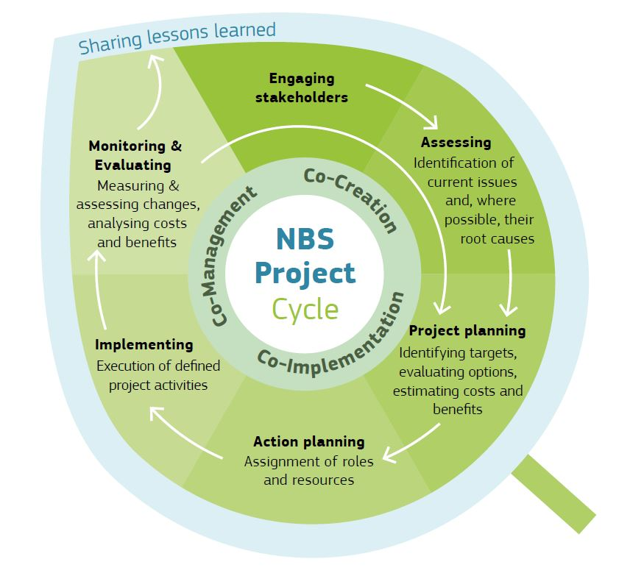
Why Evaluate NBS Performance & Impact?
NBS can support high-level objectives related to climate change adaptation and mitigation, ecosystem and biodiversity conservation and restoration, sustainable development, etc.
  Widespread adoption of NBS and their incorporation within multi-level policy instruments is hindered by fragmented and largely discipline-specific nature of existing evidence of NBS performance and impact
There is an urgent need to develop an in-depth, common understanding of both the potential benefits of Nature-Based Solutions and any associated trade-offs
Image source: Sgrigna et al. 2021. Chapter 1, Evaluating the Impact of Nature-based Solutions: A Handbook for Practitioners

Slide 3

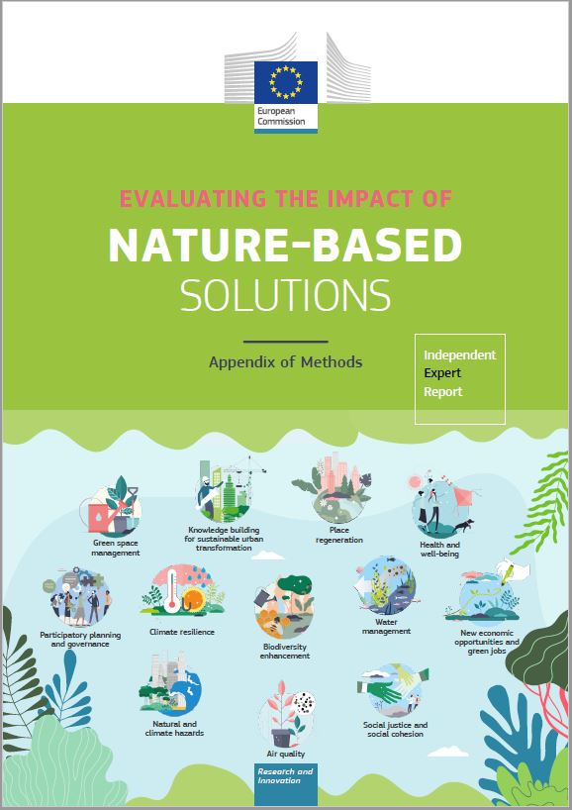

An Integrated NBS Assessment Framework
Collaboration between 17 EU-funded projects and related programmes to develop Evaluating the Impact of Nature-based Solutions: A Handbook for Practitioners & Appendix of Methods, + Summary for Policymakers
The Handbook serves as a guide to development and implementation of scientifically-valid monitoring and evaluation plans for the evaluation of NBS impacts
The Appendix of Methods provides a brief description of each method, along with guidance about the appropriateness, advantages and drawbacks of each in different contexts
Framework of common indicators and methods for assessing the performance and impact of diverse types of NBS:
  A reference for relevant EU policies and activities
  Orients practitioners in developing robust impact evaluation frameworks for NBS at different scales
  Comprehensive set of indicators and methodologies
  Key points highlighted in Summary for Policymakers

Slide 4
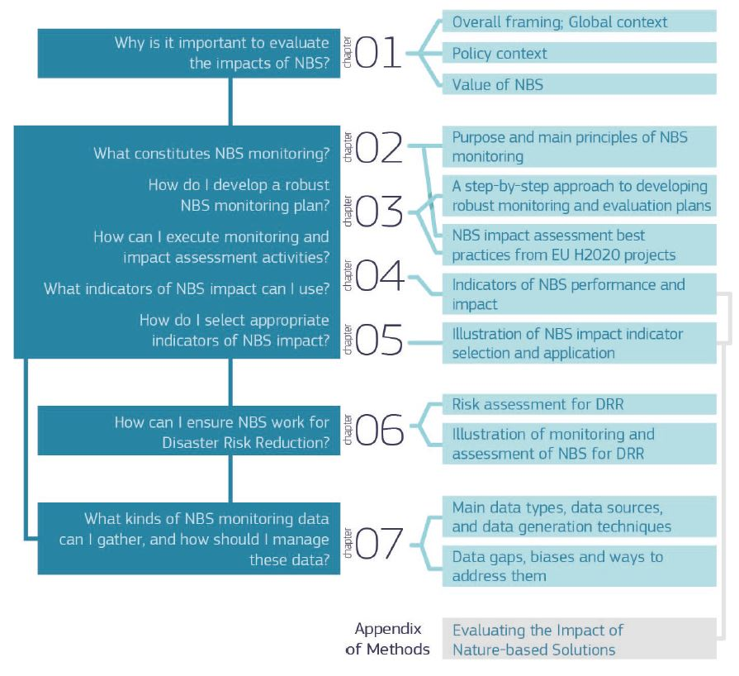

Slide 5
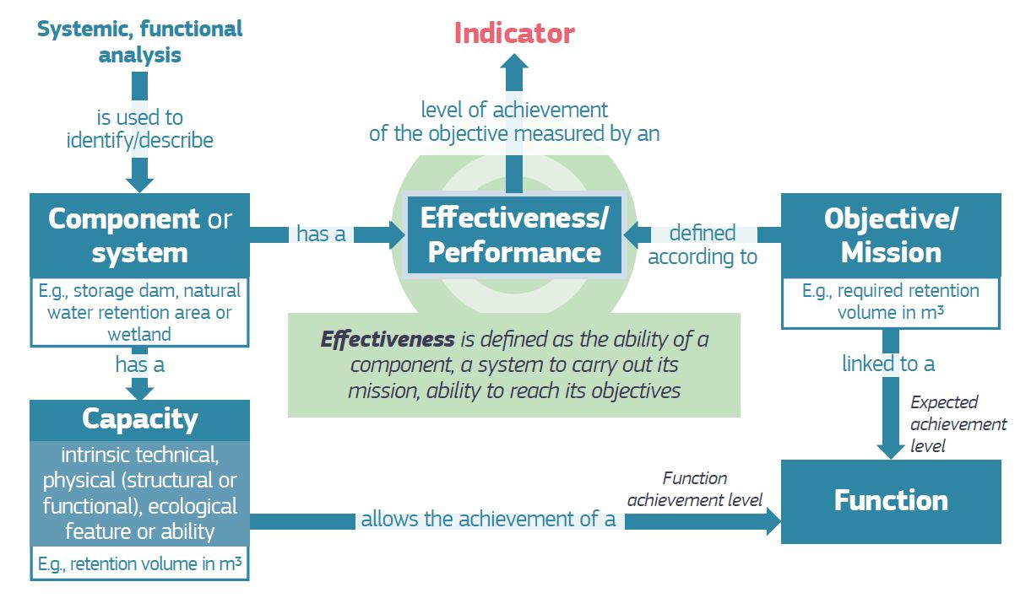
Indicators Measure NBS Effectiveness
  Monitoring of both the process and the NBS implemented is necessary to understand NBS effectiveness:
    How do the outcomes of the NBS action compare with our objectives?
Indicators of NBS performance or impact are designed to measure the extent to which NBS achieves an objective linked to an explicitly identified function
Observed changes in performance may indicate a need for maintenance or design modification
Challenge or Need → Objective → Target
Image source: Skodra et al. 2021. Chapter 2, Evaluating the Impact of Nature-Based Solutions: A Handbook for Practitioners

Slide 6
















Acknowledgements

