Slide 1
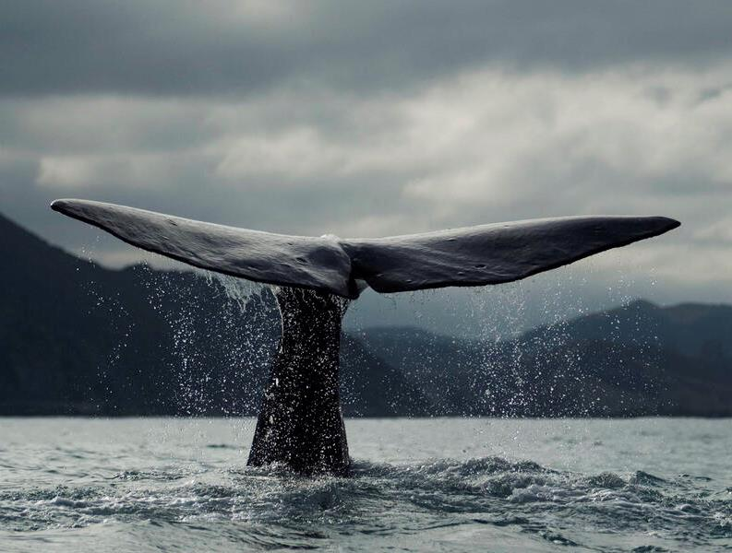

Having a whale of a time with transformative change
Peter Bridgewater
University of Canberra
Alternet ‘22
Transformative Changes
for Biodiversity and Health
Balaenoptera musculus

Slide 2
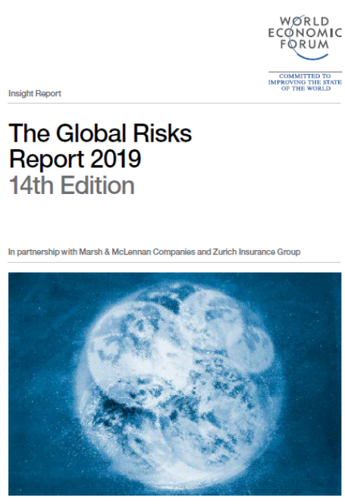
GLOBAL CONTEXT 1.
The World Economic Forum Global Risks Report for 2019 BC* featured, inter alia, biodiversity loss and ecosystem collapse.
“This means there is a vital need for clear, unambiguous advice on the status of, and drivers that
change the status of biodiversity
and ecosystem services and
importantly options and solutions to
address these challenges in an
integrated way to achieve
sustainable development.”
In 2022 Biodiversity loss rose to #3.
*Before Covid..

Slide 3
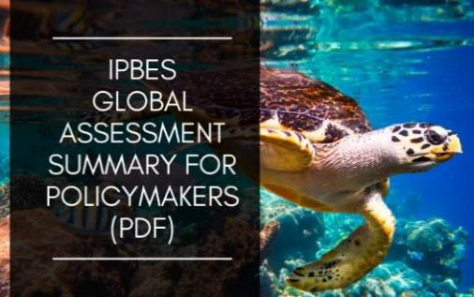
GLOBAL CONTEXT 2.
Nature can be conserved, restored and used sustainably while simultaneously meeting other global societal goals through urgent and concerted efforts fostering transformative change;
Nature is generally declining less rapidly in indigenous peoples’ land than in other lands, but is nevertheless declining, as is the knowledge of how to manage it.
Human-induced changes are creating conditions for fast biological evolution – so rapid
that its effects can be seen in only a
few years or even more quickly.
Notes:
Transformative change is facilitated by innovative governance approaches that incorporate existing approaches such as integrative, inclusive, informed and adaptive governance. While such approaches have been extensively practised and studied separately, it is increasingly recognized that together they can contribute to transformative change;

Slide 4
First, some good news…
A single Fernandina Island Galápagos giant tortoise — a species thought to be extinct for 100 years — has been found.
The female Chelonoidis phantasticus is only the second tortoise ever to be discovered on the island, after a single male, which was collected in 1906.
Researchers have also found tortoise faeces on the island, which is uninhabited and difficult to access.
Jensen, E.L., et al. The Galapagos giant tortoise Chelonoidis phantasticus is not extinct. Commun Biol 5, 546 (2022). https://doi.org/10.1038/s42003-022-03483-w

Slide 5
Oxford dictionary definition of Transformative:
causing a marked change in someone or something
So, Transformative change would be, err, Change change?
Or, Change²?
Frivolous, but also makes the point that
transformative change is not just change as we know it…

Slide 6
IPBES definition:
“fundamental, system-wide reorganization across technological, economic and social values factors, including:
Paradigms;
Goals; and
Values.”
Nature can be conserved, restored and used sustainably while simultaneously meeting other global societal goals through urgent and concerted efforts fostering transformative change

Slide 7
With that definition –
IPBES Plenary 7 approved a scoping process, for consideration at its eighth session, for a thematic assessment of the underlying causes of biodiversity loss and the determinants of transformative change to achieve the 2050 Vision for Biodiversity
(the “transformative change assessment”)
This has now launched with the first authors meeting just a month ago….

Slide 8
Humanity is on a deeply unsustainable trajectory. We are exceeding planetary boundaries and unlikely to meet many international sustainable development goals and global environmental targets.
Until recently, there was no broadly accepted framework of interventions that could ignite the transformations needed to achieve these desired targets and goals.
Chan KMA, Boyd DR, Gould RK, et al. Levers and leverage points for pathways to sustainability. People Nat. 2020;2:693–717. https://doi.org/10.1002/pan3.10124

Slide 9
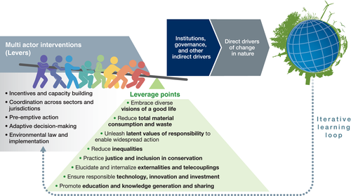
Chan KMA, Boyd DR, Gould RK, et al. Levers and leverage points for pathways to sustainability. People Nat. 2020;2:693–717. https://doi.org/10.1002/pan3.10124

Slide 10
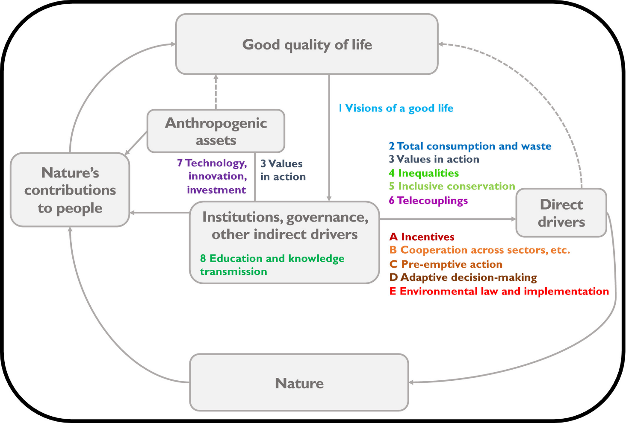
Chan KMA, Boyd DR, Gould RK, et al. Levers and leverage points for pathways to sustainability. People Nat. 2020;2:693–717. https://doi.org/10.1002/pan3.10124

Slide 11
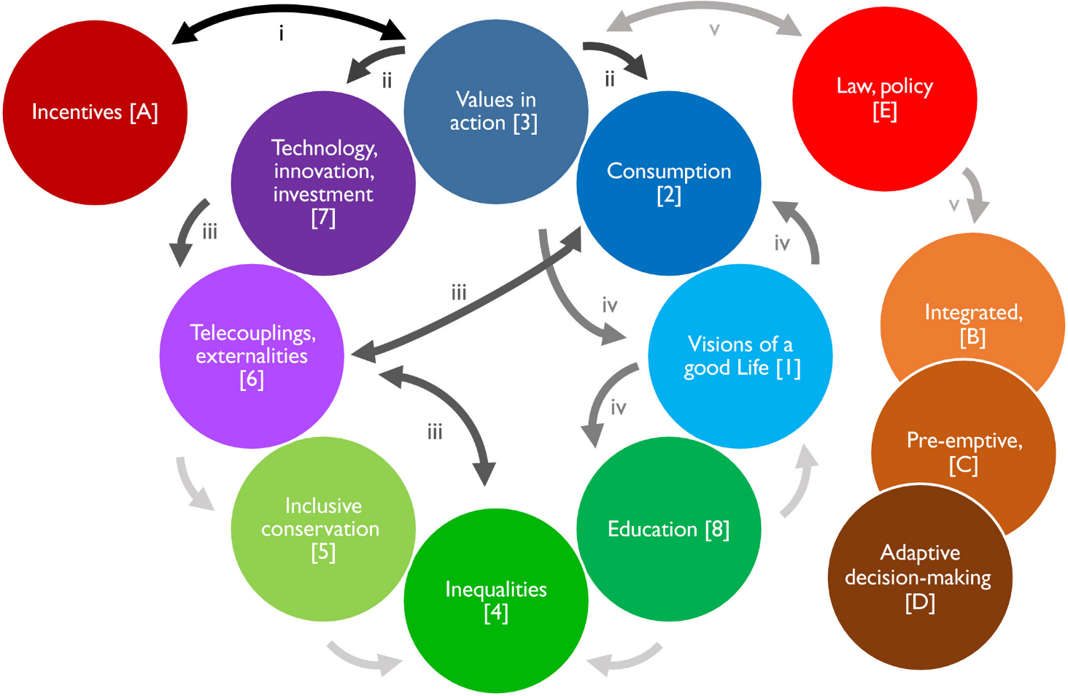





Chan KMA, Boyd DR, Gould RK, et al. Levers and leverage points for pathways to sustainability. People Nat. 2020;2:693–717. https://doi.org/10.1002/pan3.10124

Slide 12
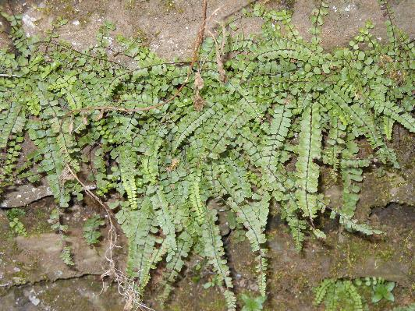
Transformative change towards sustainable pathways requires more than a simple scaling-up of sustainability initiatives—it entails addressing these levers and leverage points to change the fabric of legal, political, economic and other social systems.
Agency, power, justice, information, linkage, equity, sustainability, knowledges….
Chan KMA, Boyd DR, Gould RK, et al. Levers and leverage points for pathways to sustainability. People Nat. 2020;2:693–717. https://doi.org/10.1002/pan3.10124

Slide 13
While IPBES’ social organisation is significantly
different from previous initiatives and has created opportunities for transformative learning…… some innovative features also have had unintended
consequences for the results of the learning activities.
As a result, to live up to its ambitions of contributing to positive and transformative societal and environmental change, IPBES must strengthen its capacity for transformative learning.
Borie et al. (2020) Institutionalising reflexivity? Transformative learning and the Intergovernmental science-policy Platform on Biodiversity and Ecosystem Services (IPBES). Environmental Science & Policy 110, 71-76. https://doi.org/10.1016/j.envsci.2020.05.005

Slide 14
What none of this does is talk about time-frames.
If we are to have successful TC implemented globally
that positively affects the 2030 SD agenda,
and the 2050 CBD vision, we need it now….
And so an assessment taking until 2025 is simply
too long.
We need an assessment that itself is transformative…

Slide 15
Transformative Changes for
Biodiversity and Health
Human-nature relationships
  Cities
    Food
      Epidemics
          Invasives

Slide 16
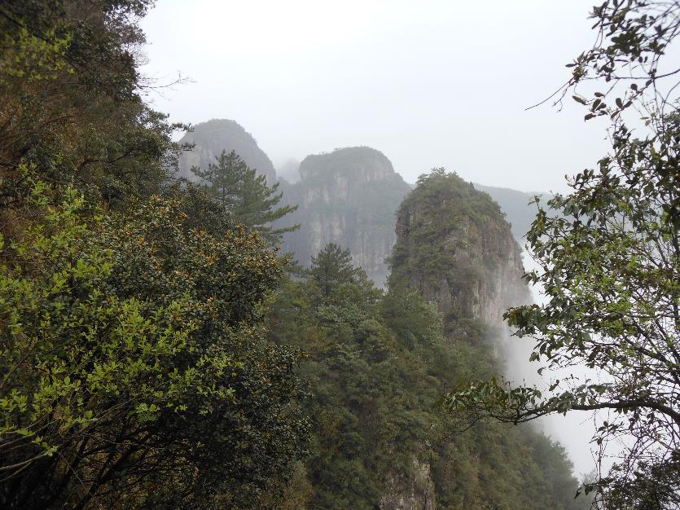
All the conference issues (plus explicitly climate change and water) are to be covered in a newly launched IPBES assessment on the NEXUS between them.
And that assessment clearly overlaps the TC assessment –still working out the roles for each assessment…

Slide 17
Questions:
Ecosystem services or natures contributions to people?
Is this debate worth having?
Health or wellness?
Is ecosystem health real?
Is 3 years a suitable time for these assessments?
Can assessments be in realtime?
Is a “levers & leverage points” approach a good idea?
If so, how could this be sold to the
political/business communities?

Slide 18
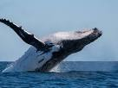

But why whales in the title of my presentation?
There are 2 good examples of TC in the international arena:
The ozone hole and
The moratorium on whaling…

Slide 19

1946 International Convention for the Regulation of Whaling (ICRW),
of which the governing body is the
International Whaling Commission (IWC)

Slide 20
The oldest, and most highly divisive, of
the wildlife conventions.
Why? Because it represents the clash -
between conservation and animal welfare;
between sustainable use and conservation;
between science, policy and law, and
between different cultural norms.

Slide 21
Convention Text
Considering that the history of whaling has seen overfishing of one area after another and of one species of whale after another to such a degree that it is essential to protect all species of whales from further over-fishing;

Slide 22
Convention Text
Having decided to conclude a convention to provide for the proper conservation of whale stocks and thus make possible the orderly development of the whaling industry;
The Contracting Governments agree to establish an International Whaling Commission, to be composed of one member from each Contracting Government.

Slide 23
The Schedule of the IWC…
Designed to show what the catches are
on an annual basis, based on a population model.
Has been set at 0 for all species since 1986
(the moratorium)–
BUT…….

Slide 24
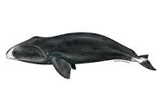
This provision (the moratorium)will be kept under review, based upon the best scientific advice, and by 1990 at the latest the Commission will undertake a comprehensive assessment of the effects of this decision on whale stocks and consider modification of this provision and the establishment of other catch limits

Slide 25
So IWC decided to remodel the model…to be termed The Revised Management Procedure (RMP) and developed by the IWC's Scientific Committee to estimate sustainable catch limits for commercial whaling of baleen whales.
Catch Limit Algorithm (CLA) done by 1994
Implementation Review – still uncompleted

Slide 26
The Commission decided that the RMP should not be implemented and used in the context of whaling until the accompanying Revised Management Scheme (RMS) was agreed.
The RMS covers the aspects of commercial whaling regulation not related to setting catch limits, such as observer schemes and record keeping.
RMS had reached an impasse in 2006

Slide 27
Timeline last 40 years:
1979 – Indian Ocean Sanctuary
1982 – Moratorium discussed
1986 – Moratorium in force, Japan agrees
but Norway and Iceland do not
1990 – Comprehensive assessment due
1991 – work begins on the RMP,
Japan seeks to implement STCW
1992 – Russia reveals misreporting

Slide 28
Timeline
1993 – Irish solution proposed
1997 - Irish solution falls
1998 – work on RMP continues, acrimony rises in IWC,
Japan increase take whales under Scientific permit,
continues pressing for STCW
2002 - following a Japanese-led challenge to
‘‘double standards’’ the IWC turned down requests
from the United States and Russia to renew quotas
for Aboriginal subsistence.

Slide 29
Timeline
2003 meeting of the IWC, more resolutions were
adopted that emphasised conservation needs
Only, IWC becomes more divisive than ever
2007 - Future of IWC initiated
2009 – Pew Whales Commission – fails
2011 – Future of IWC fails

Slide 30
Timeline
2012 IWC moves to biennial meeting
2014 – Australian ICJ case
- Japan proposal for STCW
2016 – treading water
2018 – explosion –
Japan announces it’s leaving

Slide 31
Since the moratorium on whaling in1986 populations of many species have shown an ability to recover, although the blue whale
is still in low numbers.
Various authors show that the situation is much more complex ecologically than had previously been thought - with species recovering at different rates.

Slide 32
This means different levels of competition, and
new pressures on Whale prey (krill etc.) and the
relationship with other species feeding on krill..
In the southern ocean this includes Penguins
and crab-eater seals as well as many fish species.
Add on top of that the effects of various global
changes in the southern oceans and the whale
breeding grounds in the sub-tropics, and
new levels of management complexity arise.
So, That’s it?

Slide 33
Oh wait….. The International Monetary Fund….
Its Dec 2019 edition of F&D Magazine goes blue-green..
“When it comes to saving the planet, one whale is worth
thousands of trees.”
{also talk about elephants in same vein in 2020
https://www.imf.org/en/Publications/fandd/issues/2020/09/how-african-elephants-fight-climate-change-ralph-chami }
https://www.imf.org/en/Publications/fandd/issues/2019/12/natures-solution-to-climate-change-chami

Slide 34
Coordinating the economics of whale protection must rise to the top of the global community’s climate agenda.
Since the role of whales is irreplaceable in mitigating and building resilience to climate change, their survival should be integrated into the objectives of the 190 countries that in 2015 signed the Paris Agreement for combating climate risk.
So WTF* for whales??
What’s the future.. ☺

Slide 35
Key features of the IWC issues..
Misunderstandings
Mismanagement
Duplicity
Muddling the science
Politicians families
Foot dragging
All are unintended consequences……

Slide 36
Things to think about over next 3 days on Change²….
The answer may be right –
but the question may be wrong…
  Unintended consequences –
expect unpredictability
    Being adaptive
      Using all knowledges
        Incorporating learning…

Slide 37
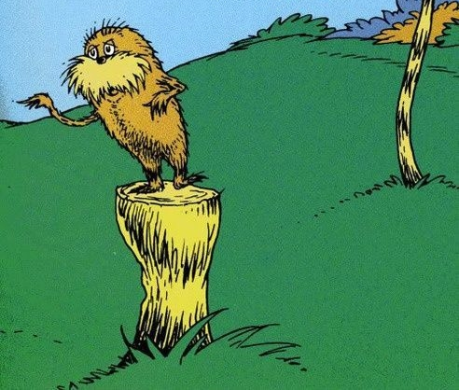
Above all – remember
we are part of,
not apart from nature…
And, with a nod to Carla, think on
the Lorax…
AND THAT IT’S
ALWAYS POLITICAL!

