Slide 1


Biodiversity in Cities
How urban pollinators show the importance of robust political ecological theory
Austin Martin
PhD student, Geography and Urban Studies
Temple University
aumartin@temple.edu

Slide 2
Talk outline
My own bee data collection and research
Explanation of the “luxury effect” concept in urban ecology and why it reveals a theory gap
Explanation of political ecology and what it can offer researchers and policymakers

Slide 3
Main argument: Political ecology enhances our understanding of biodiversity in cities

Slide 4
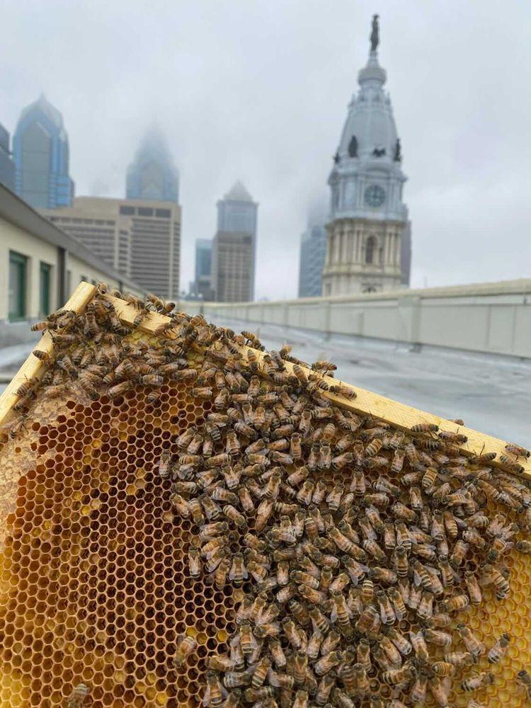
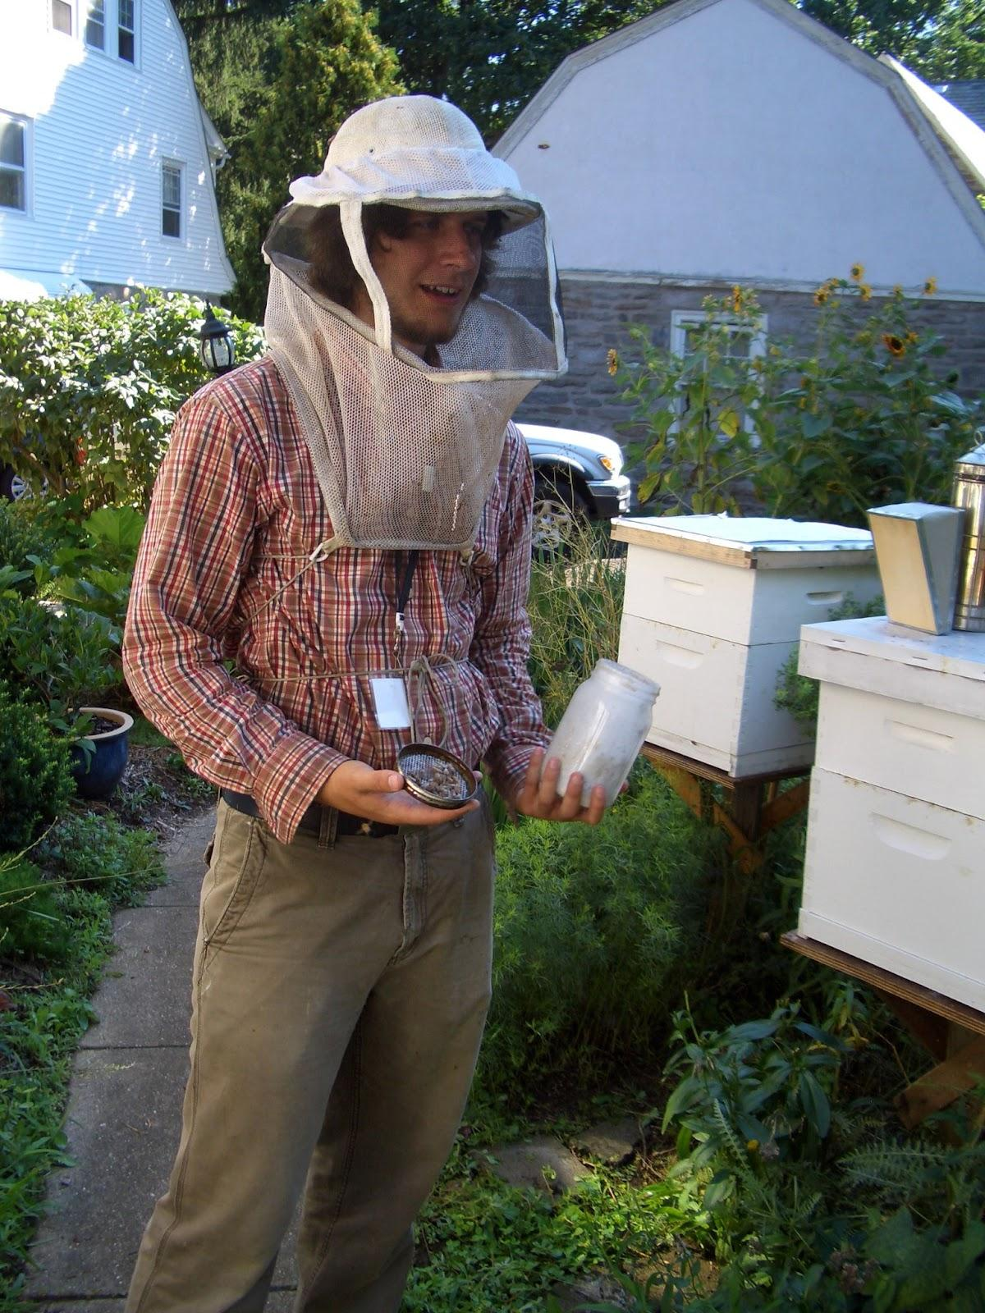
Early 2010s - Pennsylvania state apiary inspector

Slide 5

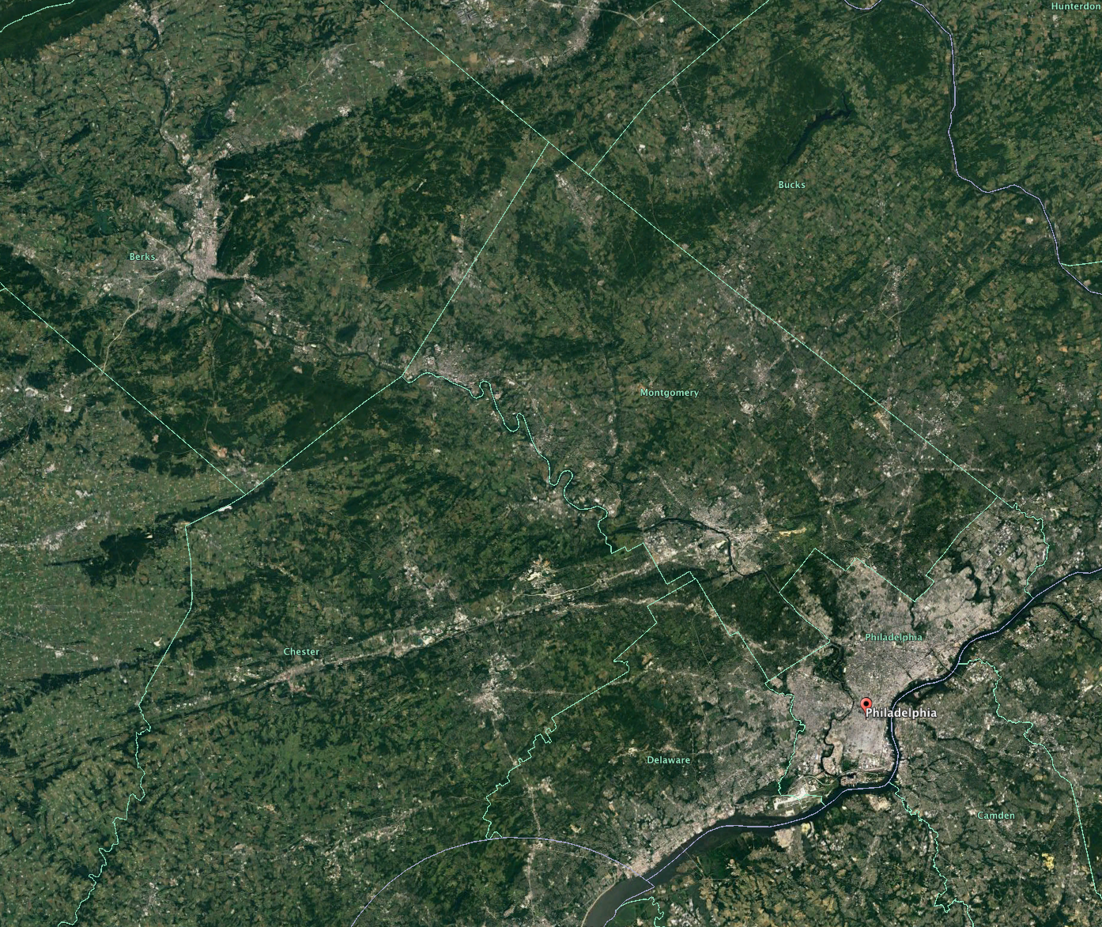
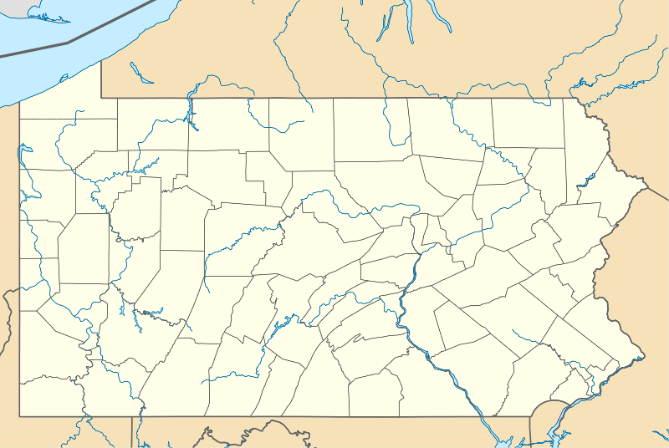
Southeastern Pennsylvania
Berks
Bucks
Montgomery
Chester
Philadelphia
Delaware

Slide 6
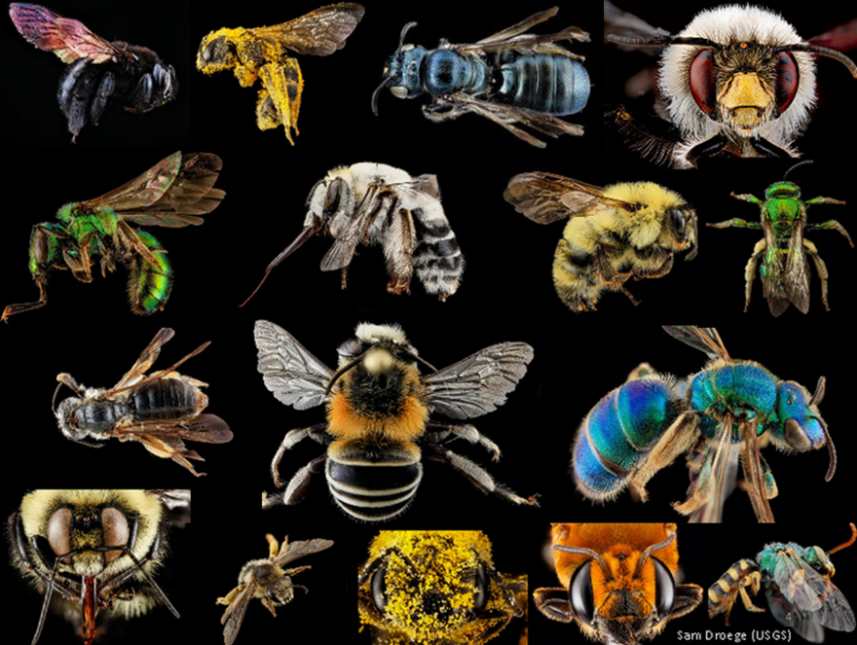
Bee diversity
~20,000 species worldwide
~2,000 species native to North America
Pennsylvania and Michigan each have ~400 of their own native bee species
Most global species are solitary

Slide 7
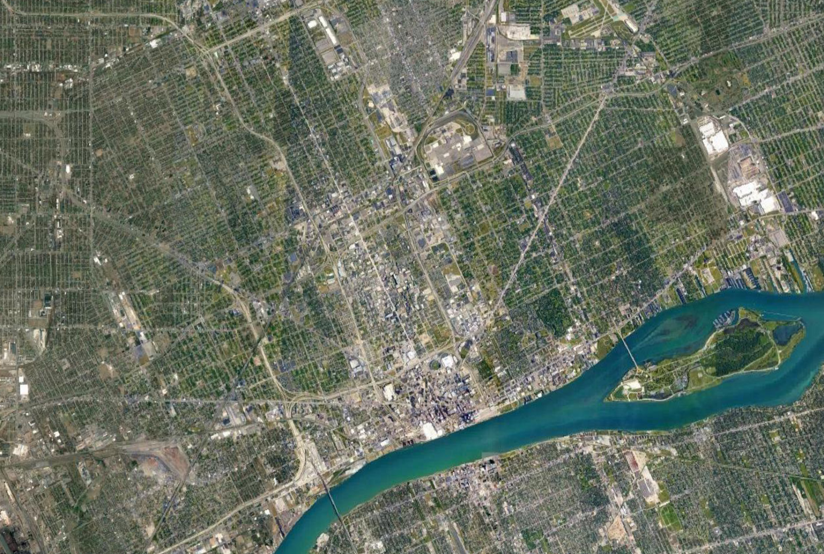
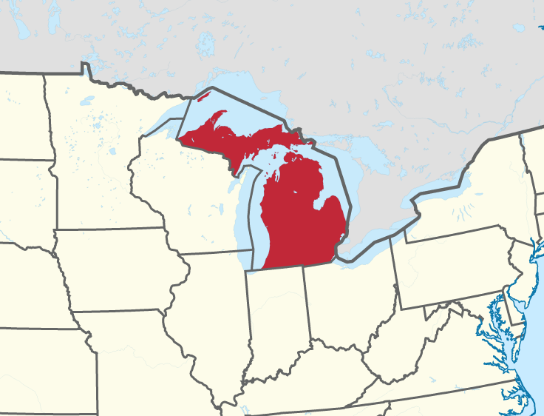
Detroit, MI

Slide 8
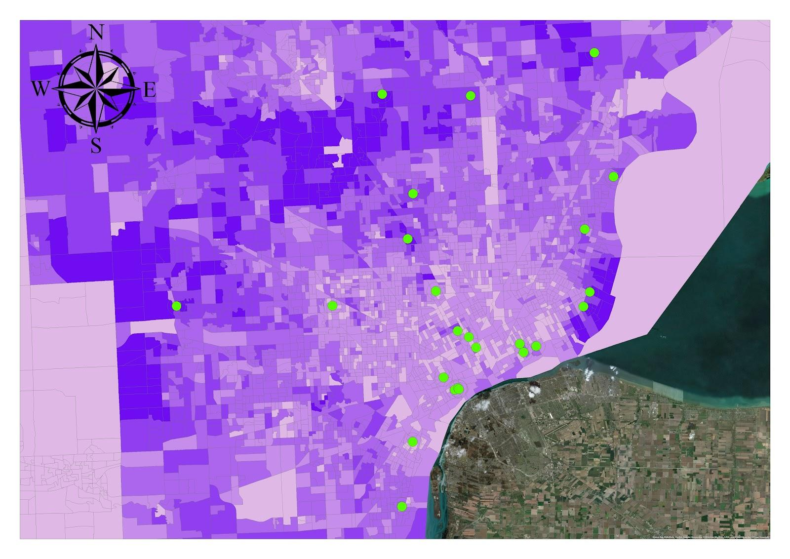

Slide 9
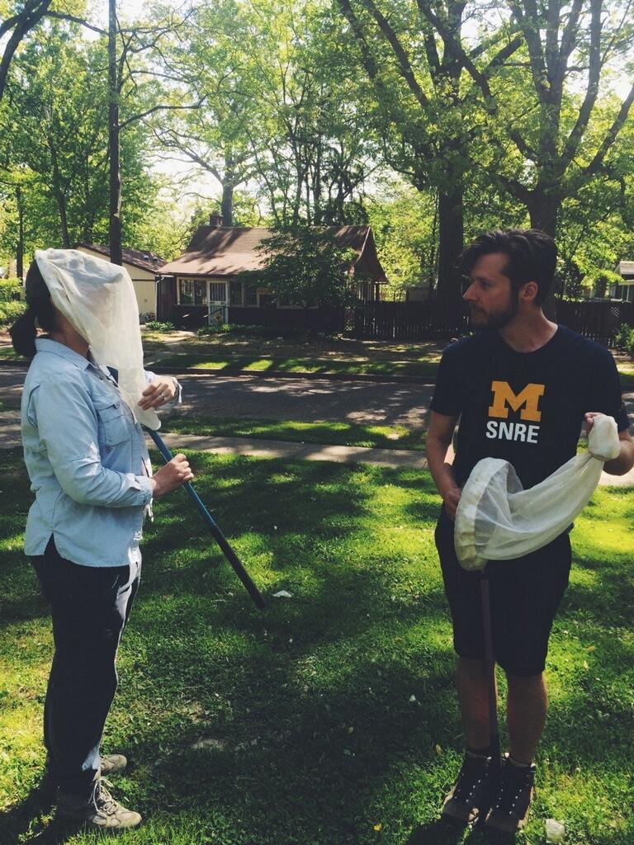

Slide 10

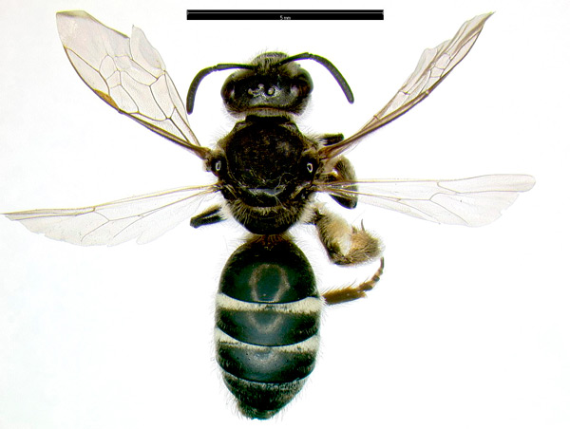
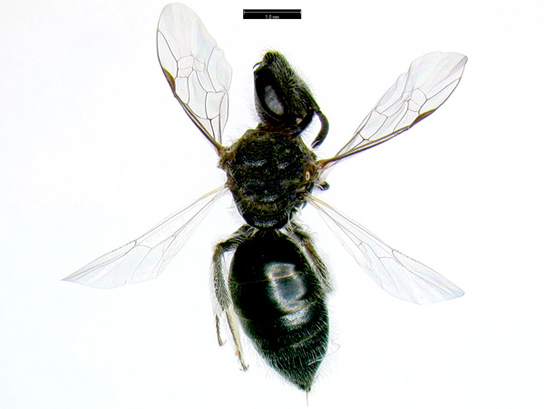
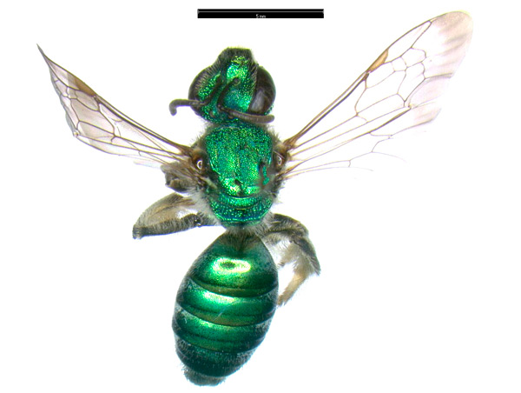
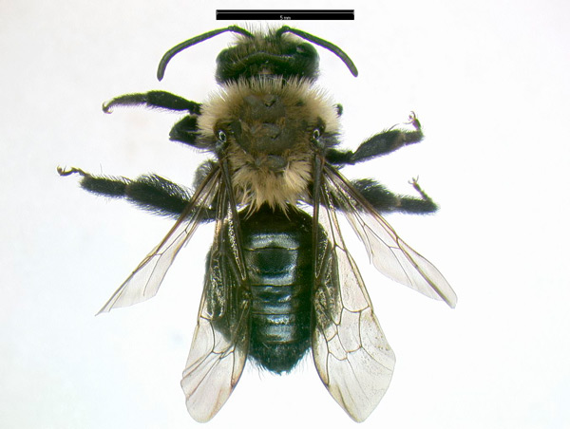
Bee diversity
Bee abundance
The higher the income, the lower the bee abundance
Bee richness
The higher the income, the lower the richness

Slide 11
Urban ecology
Sits on the nexus between the social and the natural sciences
Despite this, the discipline shies away from structural understandings of urban socio-ecological conditions

Slide 12
Luxury effect hypothesis
Cities feature a pattern of higher biodiversity in more affluent neighborhoods
Most studies show this effect for plant diversity and vegetative cover
  A few studies also show the effect with animals

Slide 13
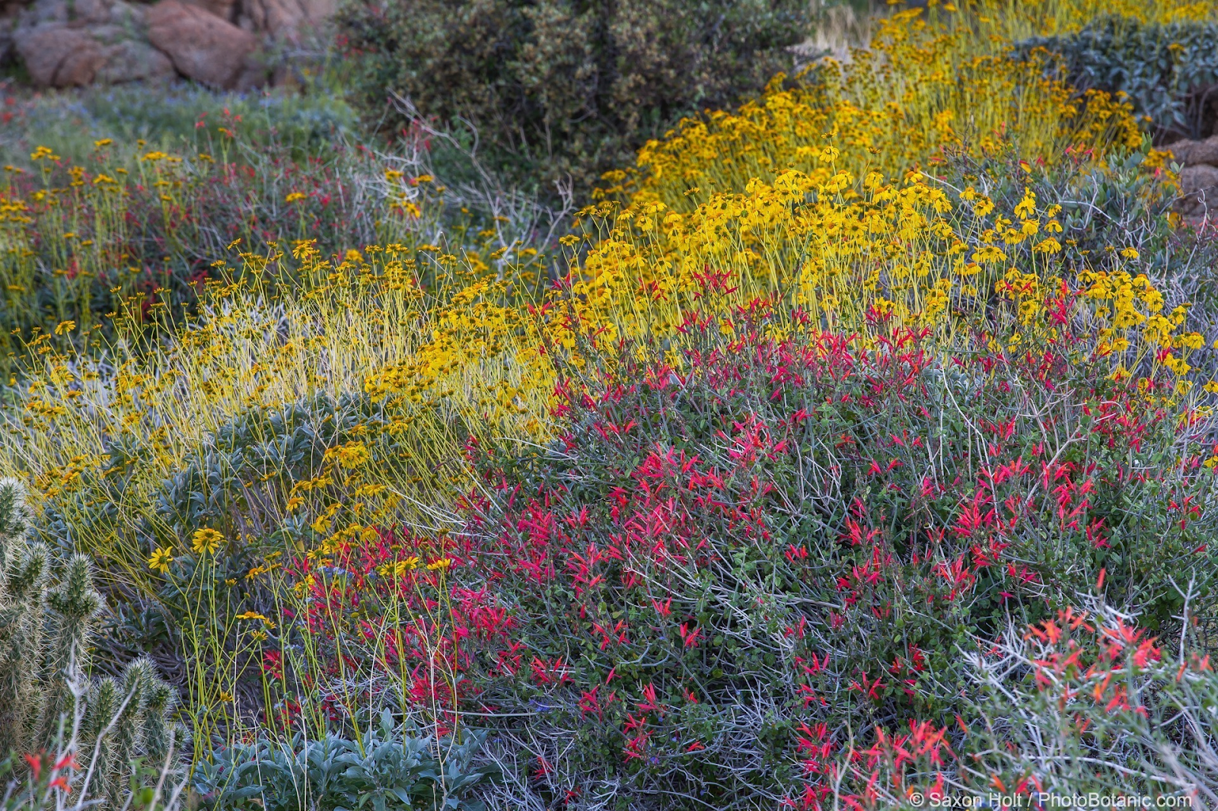
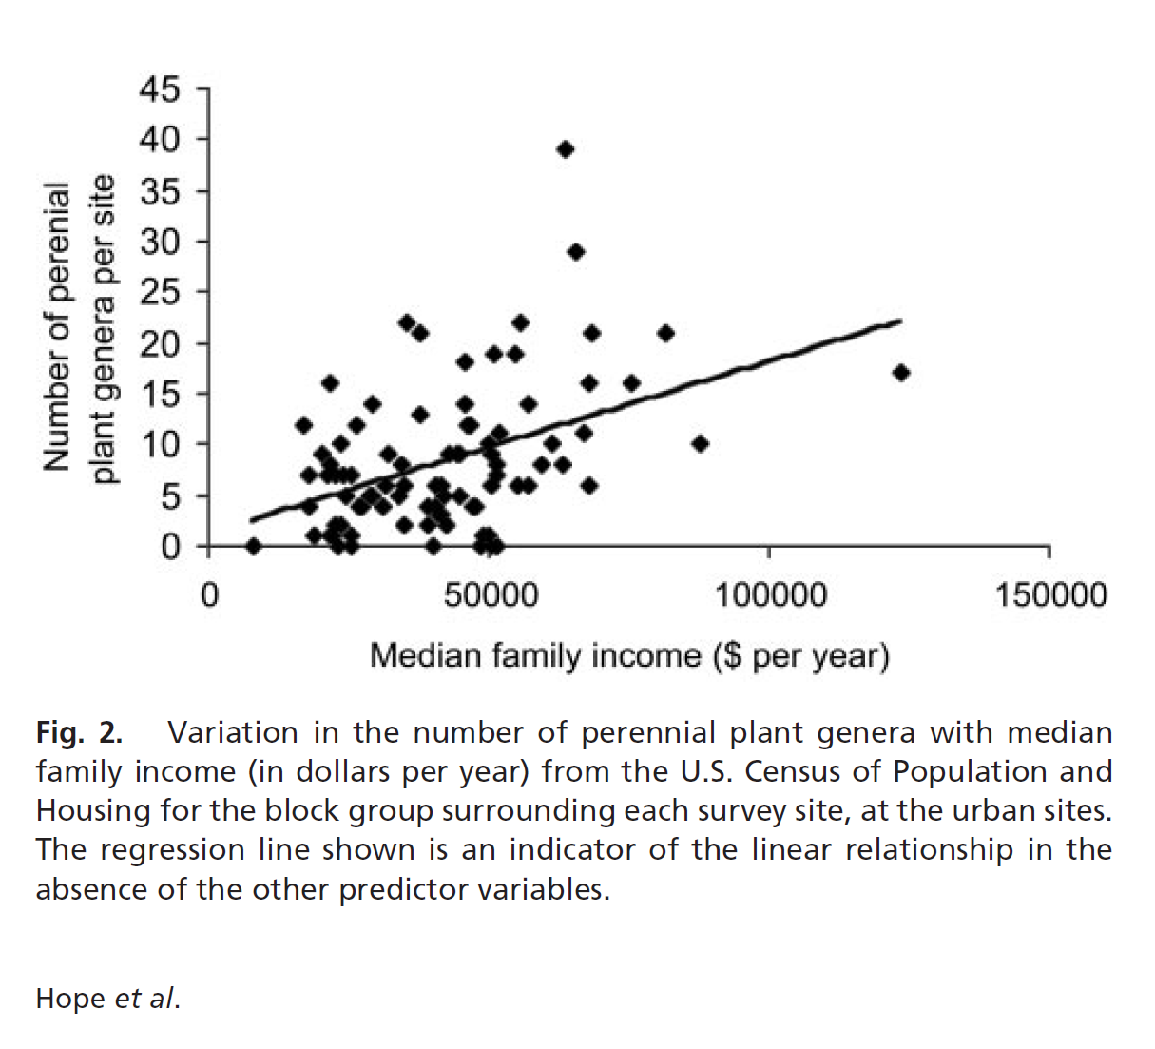
Luxury effect hypothesis
Hope et al. (2003) found that median household income at the census block level was the most important predictor for perennial woody plant diversity
2003

Slide 14
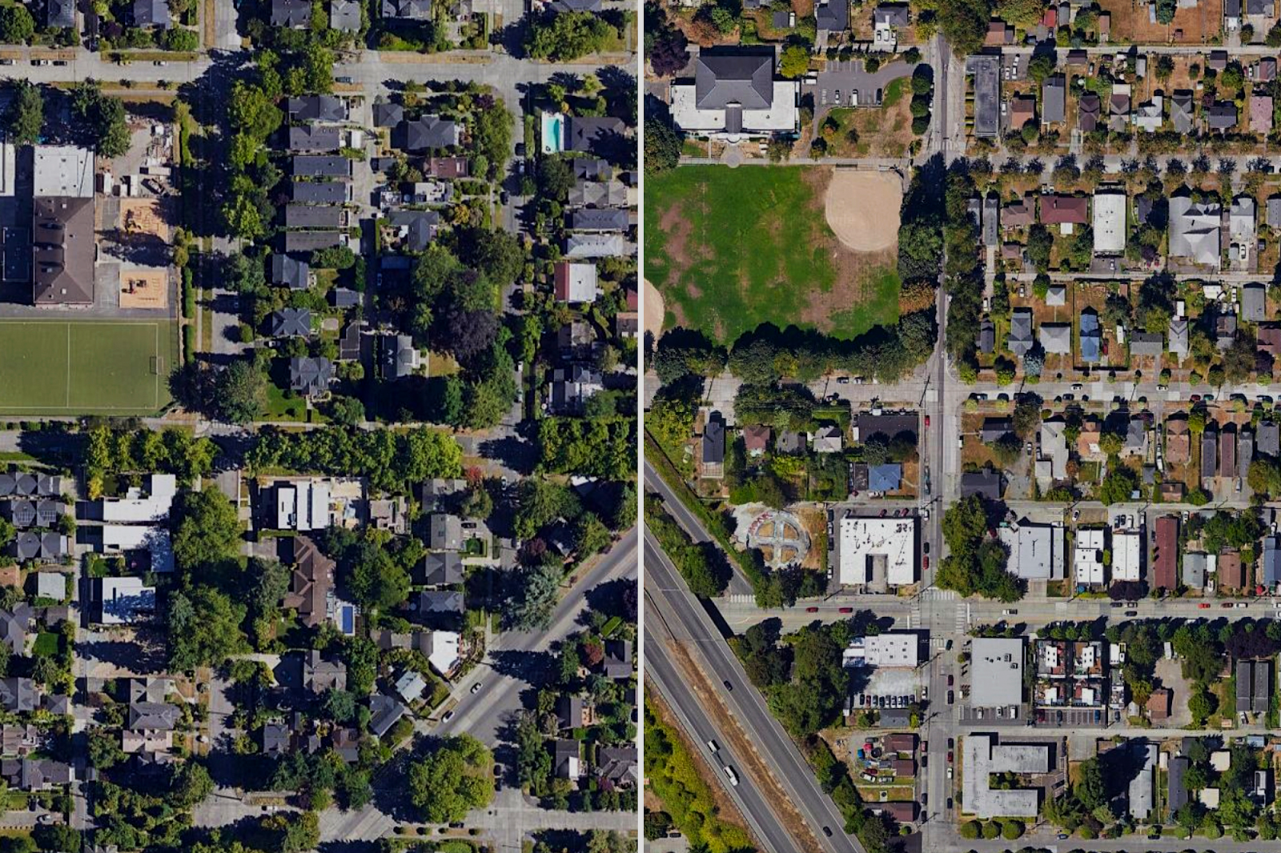
Luxury effect: why does it happen?
Higher income households have greater purchasing power (landscaping)
Higher income neighborhoods have more access to green spaces (Brander and Koets 2011; Rigolon 2016)
Neighborhood choice: humans and other species favor environmentally desirable areas (Leong et al. 2018)

Slide 15
Luxury effect: anomalous counter-examples
Kuras et al. (2020) - meta-analysis shows growing numbers of exceptions to the luxury effect
My own research on bee biodiversity in Detroit

Slide 16
Luxury effect hypothesis criticisms
Frames the consumer and their accumulated decisions as a primary driver (rather than social structures)
Atomistic
  Individual residential landholders and their personal cultural choices are seen as the primary driver of urban landscape spatial patterns
Fails to account for the political economic process

Slide 17
However, urban ecology shows signs of readiness to more thoroughly integrate with the social sciences

Slide 18
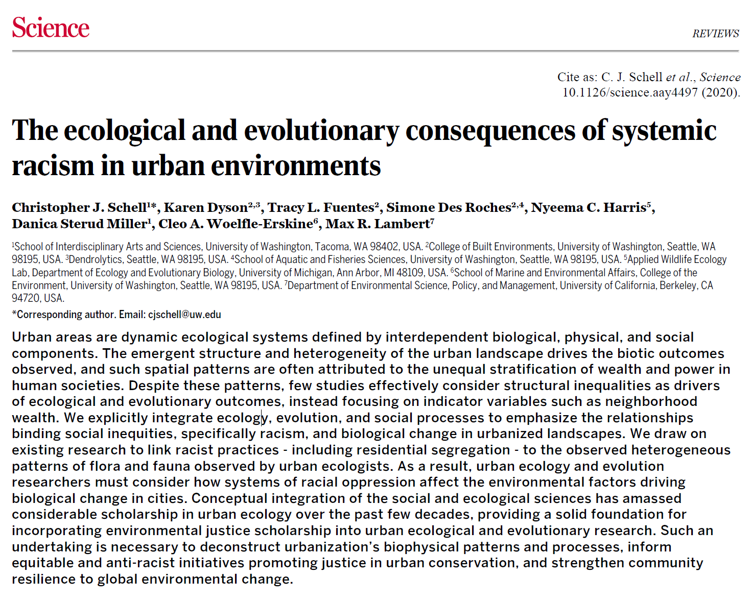
Schell et al. paper
Shows how factors contributing to urban ecological problems stem from racist and classist policies
  Example: Formerly redlined neighborhoods continue to have lower tree canopy cover

Slide 19
Schell et al. paper
“Conscious and unconscious systemic biases and stereotypes … drive and exacerbate racist and classist structures in urban systems.” (Schell et al. 2020, p. 14)

Slide 20
Schell et al. paper
“Conscious and unconscious systemic biases and stereotypes … drive and exacerbate racist and classist structures in urban systems.” (Schell et al. 2020, p. 14)
What about structural forces?

Slide 21
What political ecology can offer

Slide 22
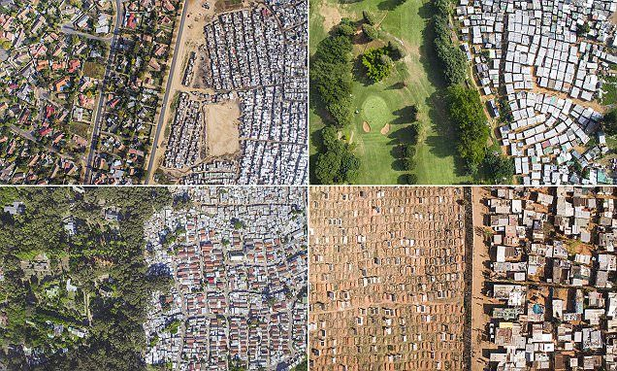
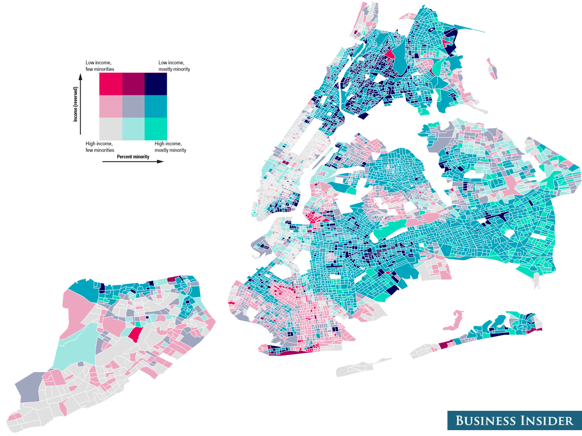
Political economic processes
Capitalist processes create uneven urban geography and development (David Harvey, Doreen Massey, Neil Smith)
  The production of uneven space is essential for capitalist growth and development

Slide 23
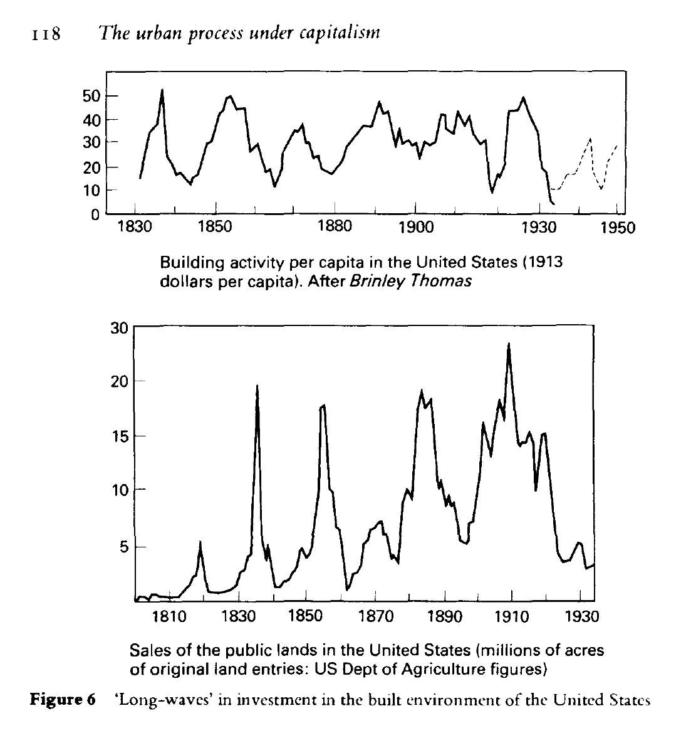
Political economic processes
These patterns drive the shape of the urban landscape over space and time (Harvey 1978)

Slide 24
The urban growth machine (Logan and Molotch 1976)
As of the 1970s, municipalities compete amongst each other for investment (zero sum)
Finance and entrepreneurial incentives control city space
  City landscapes are subject to commodification

Slide 25
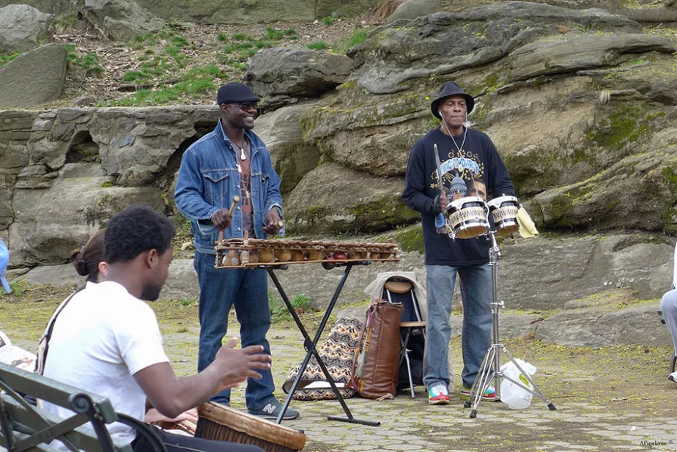
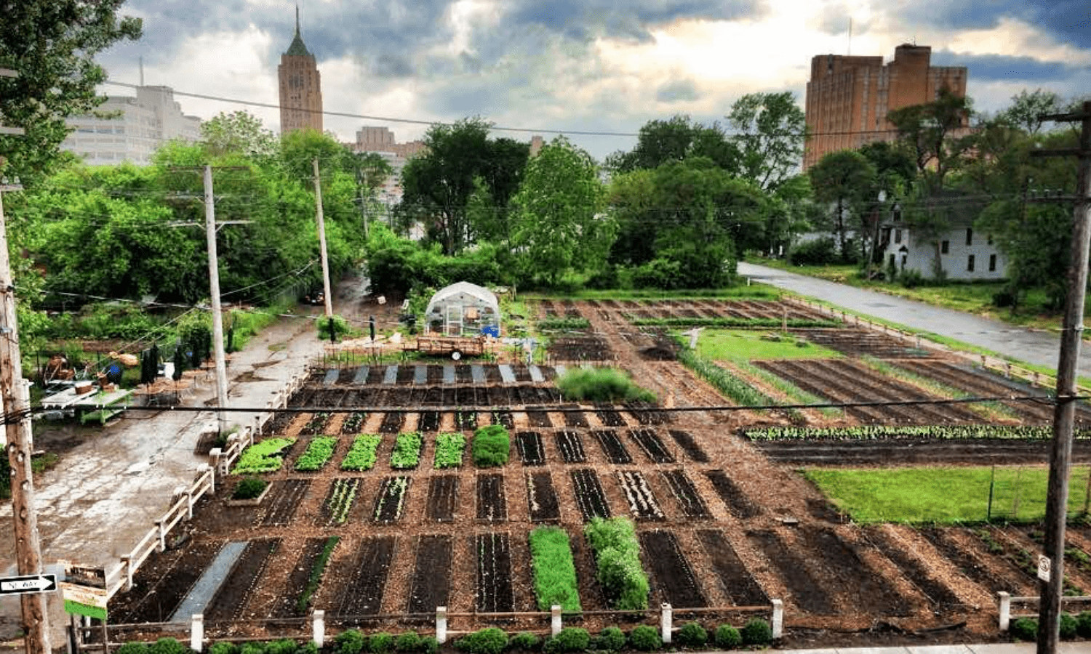
When profit-minded development causes displacement
Contradiction between use value and exchange value
City improvements to Marcus Garvey Park helped real estate but displaced the community and their culture/traditions
The summer weekend drum circle in Central Harlem’s Marcus Garvey Park (gothamtogo.com)

Slide 26
Detroit, MI

Slide 27
Political ecology enhances our understanding of pollinator biodiversity in cities.

Slide 28
Thank you!

Slide 29
Ackley, Jeffrey W., Jianguo Wu, Michael J. Angilletta, Soe W. Myint, and Brian Sullivan. 2015. “Rich Lizards: How Affluence and Land Cover Influence the Diversity and Abundance of Desert Reptiles Persisting in an Urban Landscape.” Biological Conservation 182 (February): 87–92. https://doi.org/10.1016/j.biocon.2014.11.009.
Grove, J. Morgan, Dexter H. Locke, and Jarlath P.M. O’Neil-Dunne. 2014. “An Ecology of Prestige in New York City: Examining the Relationships Among Population Density, Socio-Economic Status, Group Identity, and Residential Canopy Cover.” Environmental Management 54: 402–19. https://doi.org/10.1007/s00267-014-0310-2.
Hall, Damon. 2016. “Can Cities Save Bees? How Can Urban Habitats Be Made to Serve Pollinator Conservation? How Can That Story Be Better Told?” The Nature of Cities (blog). 2016. https://www.thenatureofcities.com/2016/01/20/can-cities-save-bees-how-can-urban-habitats-be-made-to-serve-pollinator-conservation-how-can-that-story-be-better-told/.
Hall, Damon M., Gerardo R. Camilo, Rebecca K. Tonietto, Jeff Ollerton, Karin Ahrné, Mike Arduser, John S. Ascher, et al. 2016. “The City as a Refuge for Insect Pollinators.” Conservation Biology 31 (1): 24–29.
Harvey, David. 1989. “From Managerialism to Entrepreneurialism: The Transformation in Urban Governance in Late Capitalism.” Swedish Society for Anthropology and Geography 71 (1).
———. 2001. “Globalization and the ‘Spatial Fix.’” Geographische Revue 3 (2): 23–30.
Hope, Diane, Corinna Gries, Weixing Zhu, William F Fagan, Charles L Redman, Nancy B Grimm, Amy L Nelson, Chris Martin, and Ann Kinzig. 2003. “Socioeconomics Drive Urban Plant Diversity.” Proceedings of the National Academy of Sciences 1000: 8788–92. https://doi.org/10.1073/pnas.1537557100.
Jonas, A. E. G., and A. While. 2007. “Spatial Fixes, Temporal Fixes, and Spatio-Temporal Fixes.” In The Sustainable Development Paradox: Urban Political Economy in the United States and Europe, 123–59. New York: Guilford.
Kuhn, Thomas. 1970. The Structure of Scientific Revolutions: Foundations of the Unity of Science. 2nd ed. Chicago: University of Chicago Press.
Kuras, Evan R., Paige S. Warren, John Aloysius Zinda, Myla F.J. Aronson, Sarel Cillers, Mark A. Goddard, Charles H. Nilon, and Richelle Winkler. 2020. “Urban Socioeconomic Inequality and Biodiversity Often Converge, but Not Always: A Global Meta-Analysis.” Landscape and Urban Planning 198. https://doi.org/10.1016/j.landurbplan.2020.103799.
Kuruneri-Chitepo, Chiyedza, and Charlie M. Shackleton. 2011. “The Distribution, Abundance and Composition of Street Trees in Selected Towns of the Eastern Cape, South Africa.” Urban Forestry & Urban Greening 10 (3): 247–54. https://doi.org/10.1016/j.ufug.2011.06.001.
Leong, Misha, Robert R. Dunn, and Michelle D. Trautwein. 2018. “Biodiversity and Socioeconomics in the City: A Review of the Luxury Effect.” Biology Letters 14 (5): 20180082. https://doi.org/10.1098/rsbl.2018.0082.
McDonnell, Mark J. 2011. “The History of Urban Ecology.” Urban Ecology: Patterns, Processes, and Applications. https://doi.org/DOI:10.1093/acprof:oso/9780199563562.003.0002.
Molotch, Harvey. 1976. “The City as a Growth Machine: Toward a Political Economy of Place.” American Journal of Sociology 82 (2): 309–32.
Rigolon, Alessandro. 2016. “A Complex Landscape of Inequity in Access to Urban Parks: A Literature Review.” Landscape and Urban Planning 153 (September): 160–69. https://doi.org/10.1016/j.landurbplan.2016.05.017.
Rothstein, Richard. 2018. The Color of Law: A Forgotten History of How Our Government Segregated America. Liveright.
Schell, Christopher J., Karen Dyson, Tracy L. Fuentes, Simone Des Roches, Nyeema C. Harris, Danica Sterud Miller, Cleo A. Woelfle-Erskine, and Max R. Lambert. 2020. “The Ecological and Evolutionary Consequences of Systemic Racism in Urban Environments.” Science.
Stein, Samuel. 2019. Capital City: Gentrification and the Real Estate State. London ; Brooklyn, NY: Verso.
While, Aidan, Andrew E. G. Jonas, and David Gibbs. 2004. “The Environment and the Entrepreneurial City: Searching for the Urban ‘Sustainability Fix’ in Manchester and Leeds.” International Journal of Urban and Regional Research 28 (3): 549–69. https://doi.org/10.1111/j.0309-1317.2004.00535.x.
Young, Robert F. 2009. “Interdisciplinary Foundations of Urban Ecology.” Urban Ecosystems 12 (3): 311–31. https://doi.org/10.1007/s11252-009-0095-x.

