Slide 1

Sharing (sub)urban protected areas – the agro-ecological farmers’ perspective
Laura Lauwers, Yvana Van Kerckhove and Myriam Dumortier
Alternet Conference, Ghent, 15 June 2020
Session - Transforming Food Systems
LOCK-INS AND LEVERS TO RE-LOCALIZE FOOD SYSTEMS

Slide 2
Research Institute on Nature and Forest
Programme on Agricuture and biodiversity
1. Monitoring Biodiversity in the Agricultural Area
State of Biodiversity
Effectiveness of measures
Pressure of agriculture on protected areas
2. Positive practices – functional biodiversity in the agricultural area – agriculture supporting biodiversity in protected areas
Cereal farming with nature (Flemish region)
Agro-ecological farming in protected areas in Brussels (Brussels Capital region)
PARTRIDGE (Interreg)
3. Policy support
Policy advice (e.g. on the CAP)
Reporting on the state of nature
Contracts 2.0 (Horizon 2020)

Slide 3
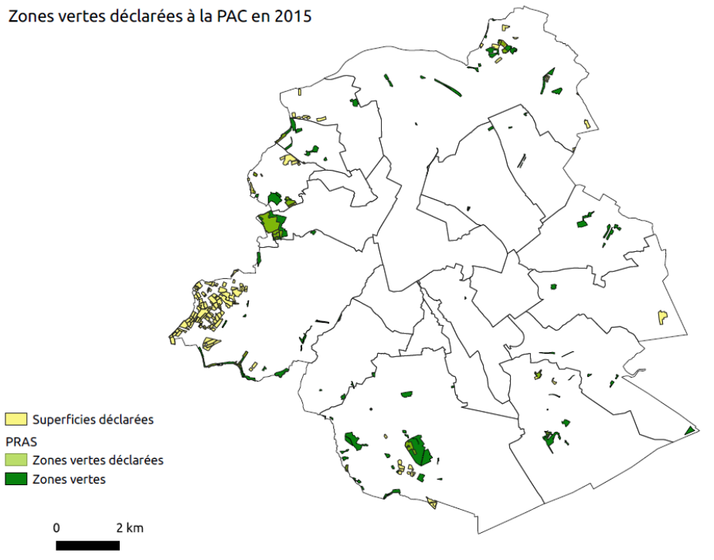
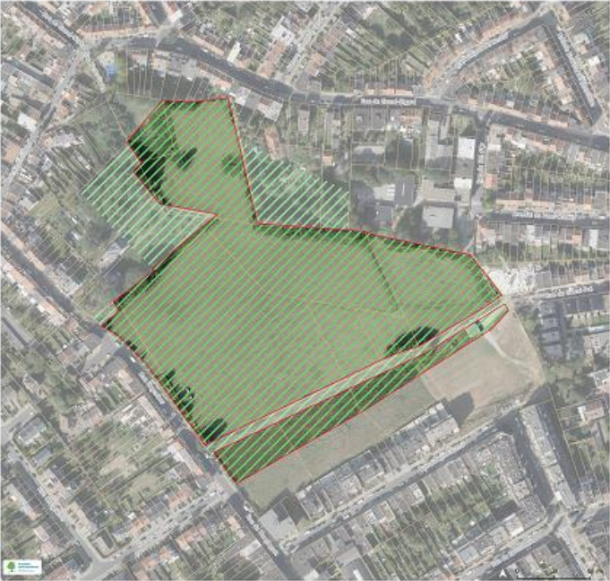
Brussels Capital Region
Last patches of agricultural land

Slide 4

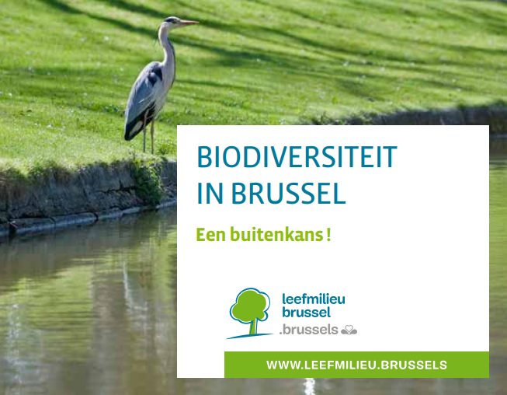
Brussels Capital Region
Good Food Strategy
Biodiversity Crisis - Nature Plan

Slide 5
Synergies between agro-ecological farming and nature conservation in protected areas
Objectives
Inspire the Brussels-Capital Region on the possibilities of agro-ecological farming in protected areas (in (former) agricultural use)
Explore the synergies and conflicts between agro-ecological farming and nature conservation in protected areas
Create a first dialogue on this theme between relevant stakeholders in the Brussels-Capital Region
Footnotes
Protected areas with lower biological value -> increase biological value through agriculture
Place for agro-ecological farming = agricultural area
Green/agricultural patches within residential or industrial areas -> time to reconsider

Slide 6
Synergies between agro-ecological farming and nature conservation in protected areas
Phase 1 – Exploring the scene
Literature review -> theoretical framework
Online survey (NL-FR-EN) -> analysis of 76 cases
Phase 2 - Case analysis
Selection of 8 most relevant cases for Brussels
Interviews -> in-depth analysis of 8 most relevant cases
Phase 3 - Validation of results
Local validation of results with stakeholders from a local municipality
Regular meetings of advisory committee, in the field, with stakeholders from the Brussels region

Slide 7
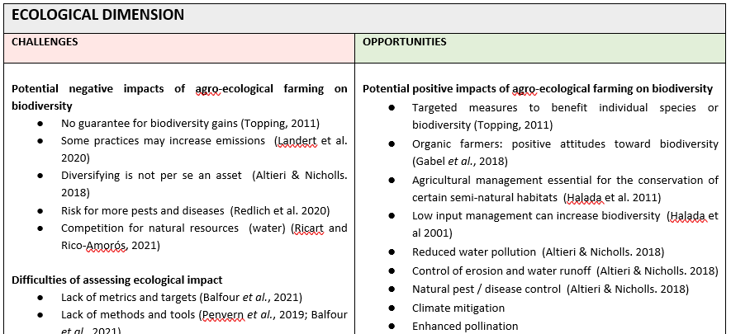
Methodology - Phase 1 – Theoretical framework
Literature review on challenges and opportunities of agro-ecological farming in protected areas
Ecological dimension
Social dimension
Economic dimension
Institutional
dimension

Slide 8
Methodology - Phase 1 – Online survey
Objective = search for inspiring examples
agro-ecological practices
economically viable
applied in protected areas (in Western Europe)
Questions
obligations and restrictions
conservation and agro-ecological measures
conflicts and collaborations
Dissemination of survey (in Dutch, English and French)
agro-ecological and nature conservation networks (160)
practices already found (60)
Response
76 complete answers

Slide 9
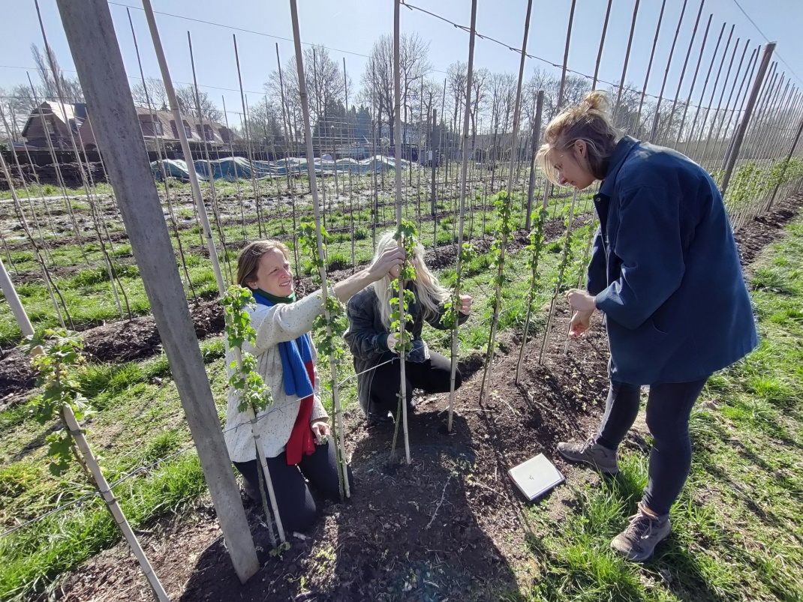
Methodology - Phase 2 - In-depth case analysis
Selection of cases for in-depth analysis
Urban/Peri-urban OR Rural (<= 10 ha)
Protected area
Ecological and social dimension
Experience with conflicts AND/OR collaborations
Economic viability: full time / part time
Economic stability: fairly stable / stable income
  18 cases => selection of 8 cases together with advisory committee
Interview script
Protected status
Ecological characteristics
Social characteristics
Economic characteristics
Institutional characteristics
Interviewing while helping

Slide 10
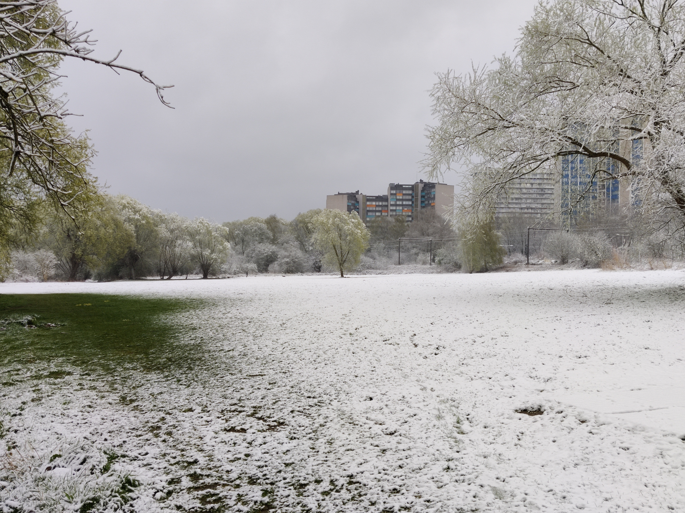
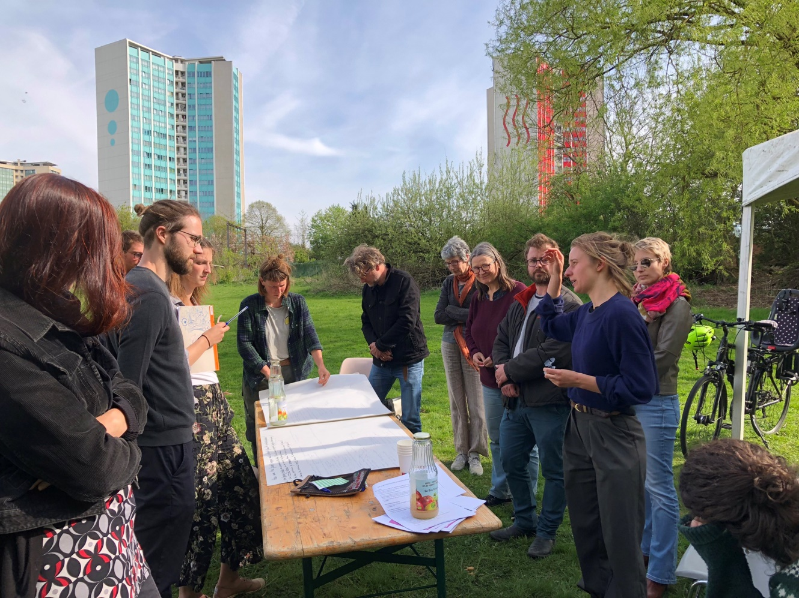
Methodology - Phase 3 - Local validation of the project results
  Workshop in the field, with local stakeholders (local municipality, farmers, nature organisations)
  Interactions between agro-ecological farm and the protected area
  Interactions between agro-ecological farm and the neighborhood
  How governments can facilitate

Slide 11
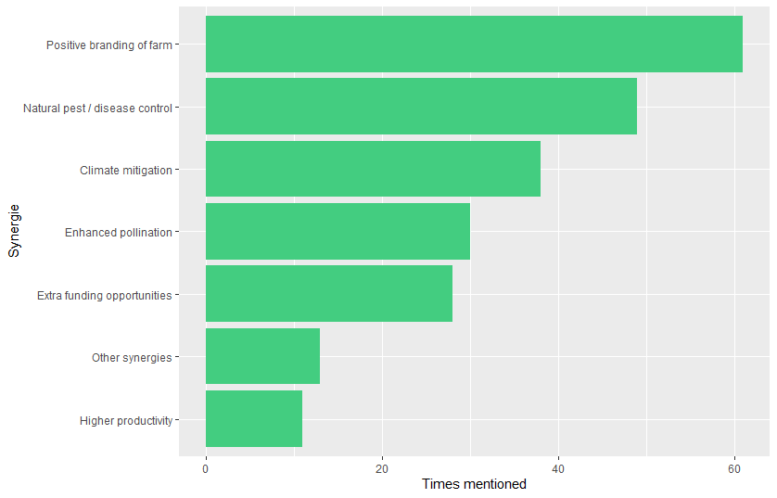
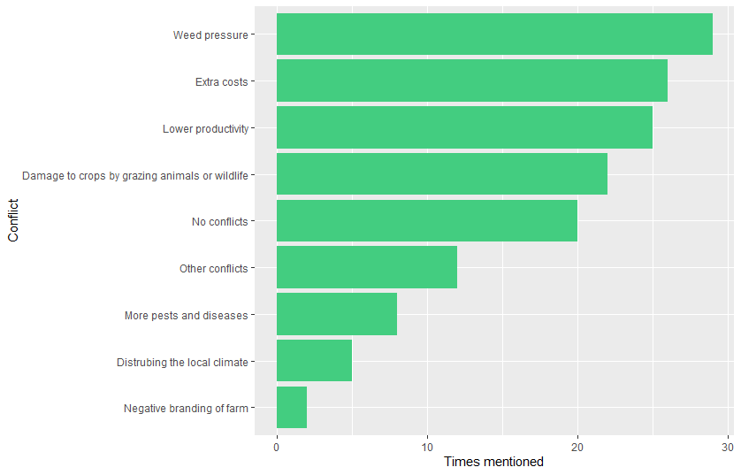
Some survey results
Synergies and conflicts between agro-ecological farming and nature
Synergies Conflicts
Positive branding
Weed pressure
Extra costs
Natural pest/disease control
Lower productivity
Climate change adaptation
Damage by grazing animals/wildlife
Pollination
No conflicts
Extra funding opportunities
0
60
0
30
More synergies than conflicts between agro-ecological farming and nature conservation

Slide 12
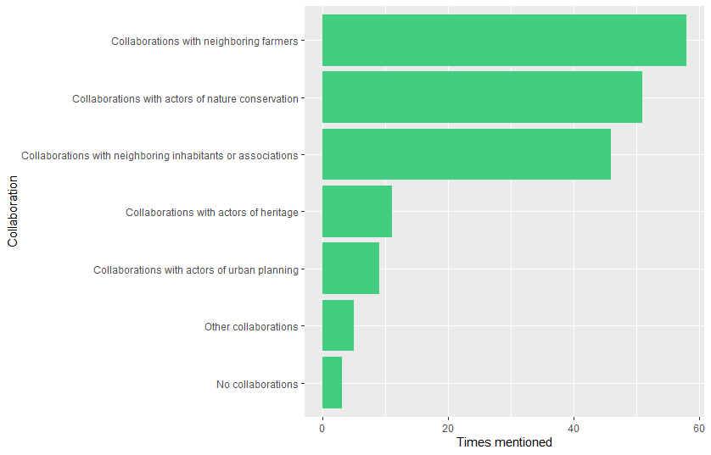
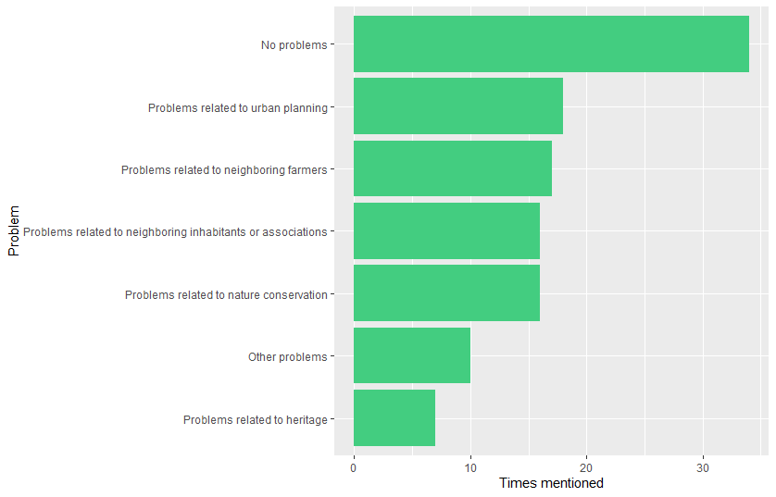
Some survey results
Collaborations and problems with other actors
Collaborations Problems with others
Neighbouring farmers
No problems
Actors in nature conservation
Urban planning
Other neighbours
Neighbouring farmers
Other neighbours
Actors in nature conservation
0
60
More collaborations than problems with other actors
0
30

Slide 13
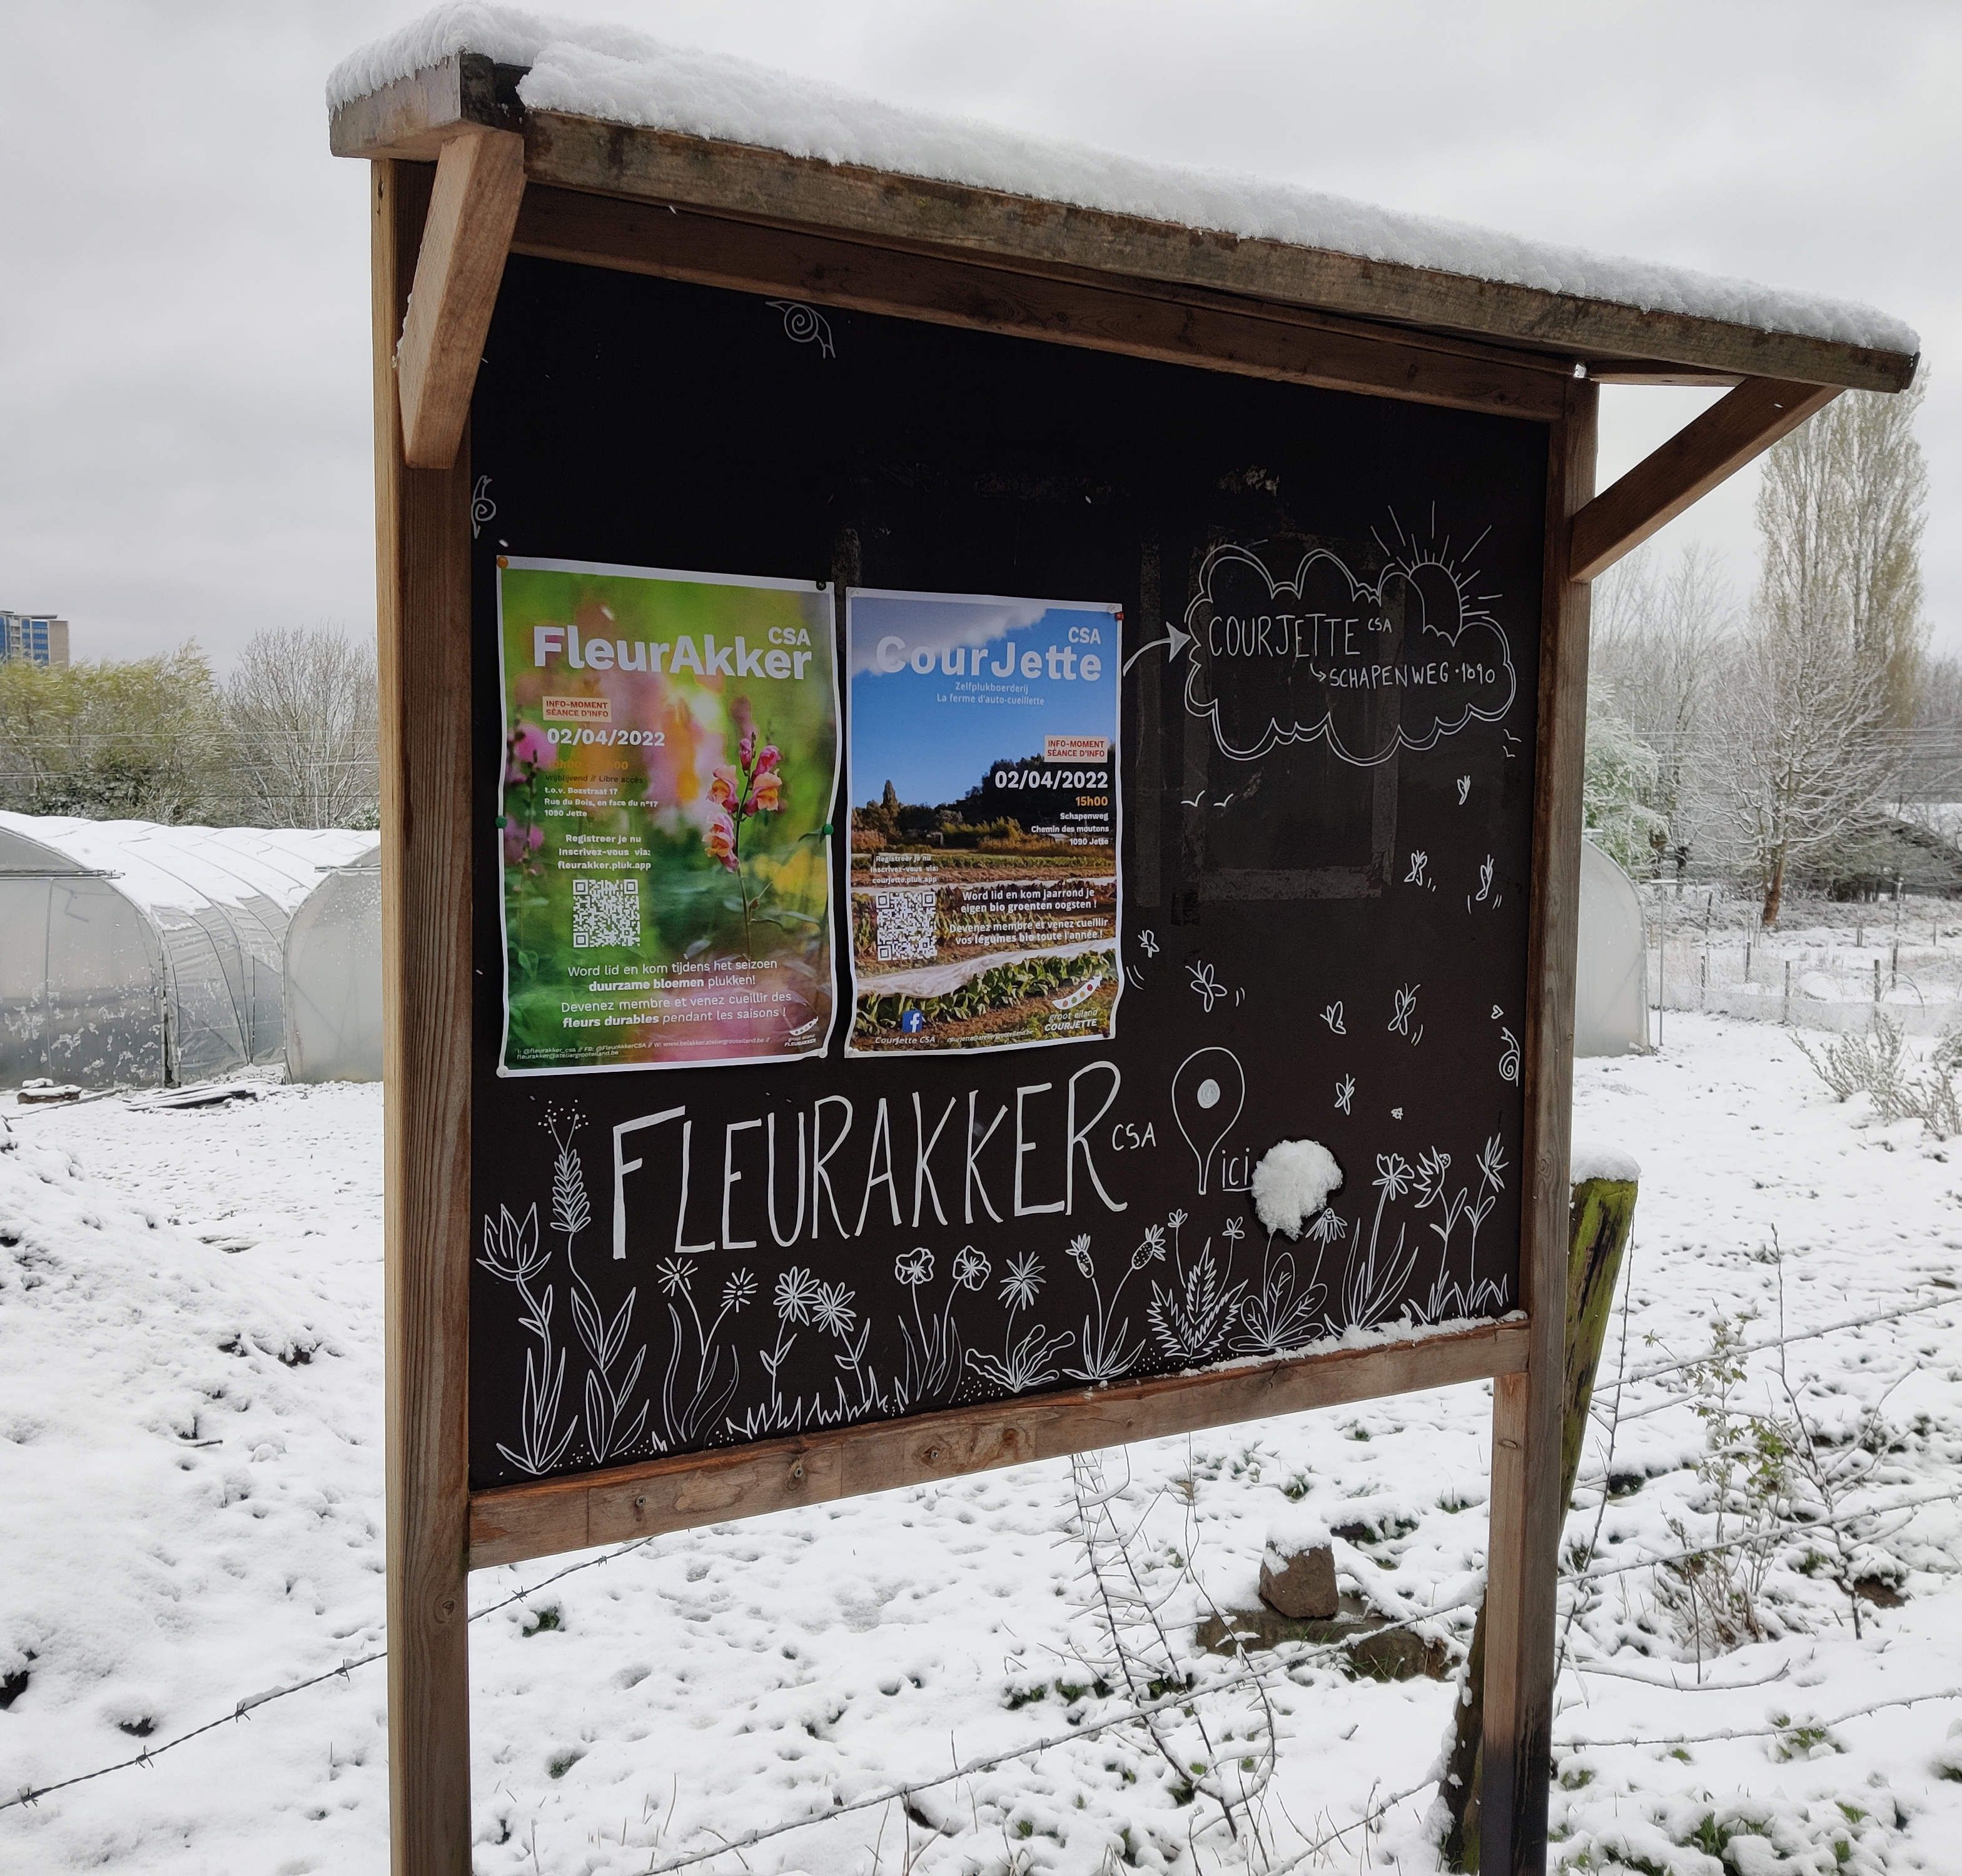
General findings from survey, interviews and local validation
High job satisfaction
Strong commitment towards nature & society
Struggle with legislation and administration
Uncertainty about longer term access to land
Synergies and trade-offs between nature and agriculture
Lifelong learning and experimenting process

Slide 14
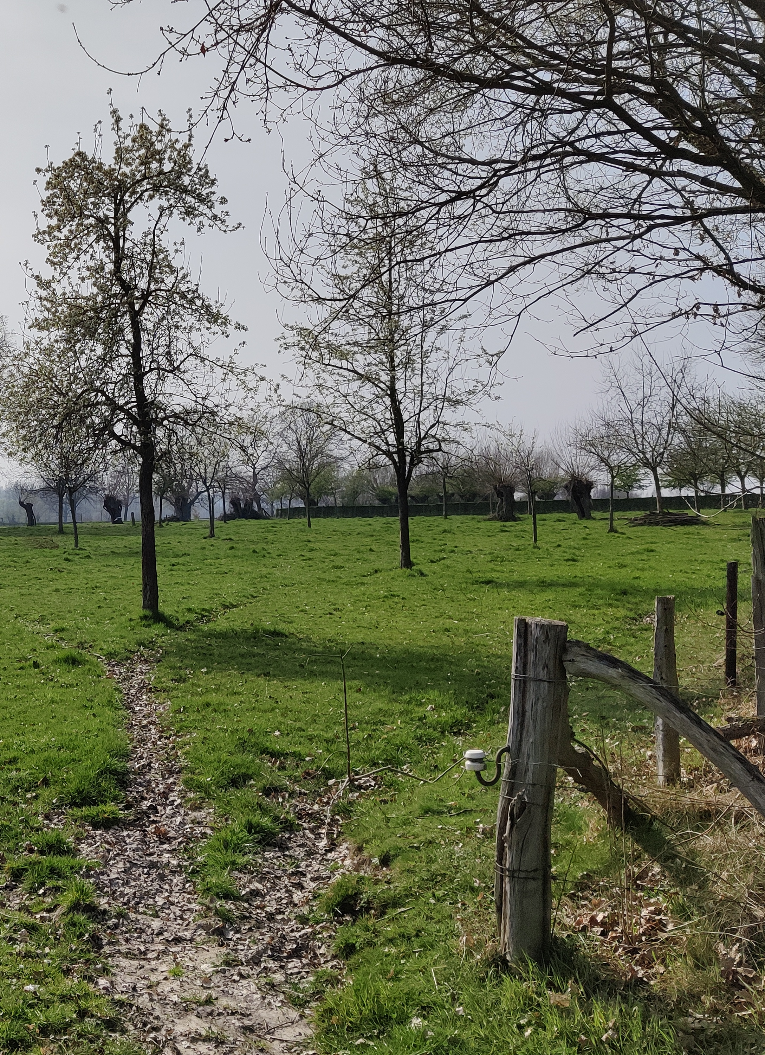
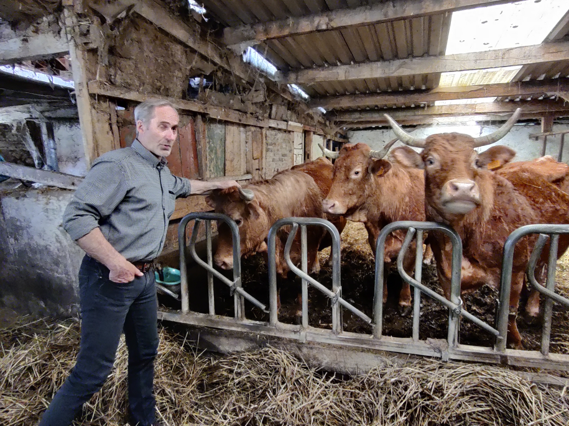
1. High job satisfaction
Natboshoeve

Slide 15
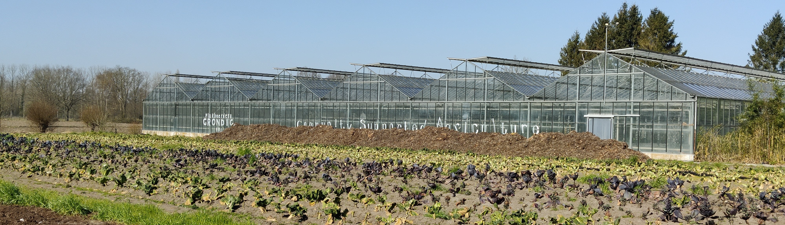
2. Strong commitment towards nature & society
Reconnecting people with nature & agriculture
Supported by nature and the community
“We don't talk about nature, but it is the stepping stone to nature because you have lots of green, and lots of animals, and the same plants that grow elsewhere.”
“The community helps tremendously. Building a branch wall is typically something that the volunteers or participants do.”
Multitude of expectations towards agro-ecological farmers
“People with burnout, schools that have care requests, timeout projects for young people. The expectations of a farm are very high and so is our willpower. But it is all on our own initiative and within our own time.”
Plukboerderij Grondig: Supported by a strong community

Slide 16
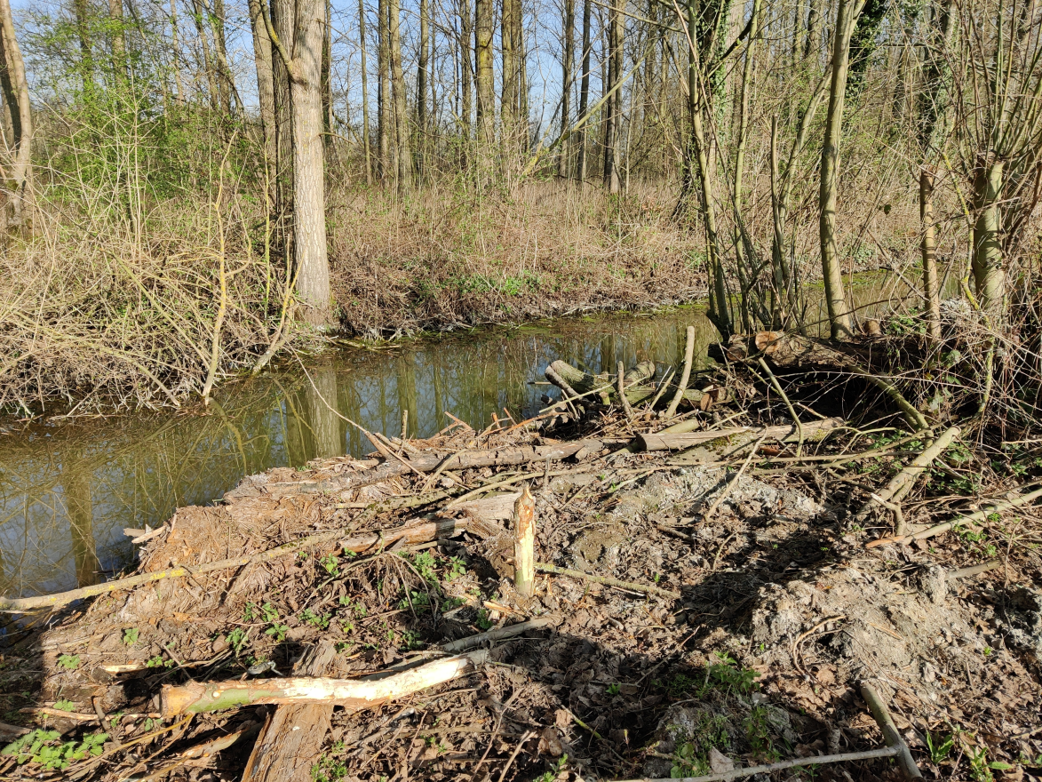
3. Struggle with legislation and administration
Plenty of restrictions
“We want to integrate more trees into agricultural practice, but this is not allowed. There is also a need for a shed, but this is also not allowed. As a result, the machines have to be outside and that is not good.”
Plukboerderij Grondig: beavers, what to do?
Some suggestions:
Provide clarity about what is (not) allowed
Simplify and accelerate administration
Dialogue

Slide 17
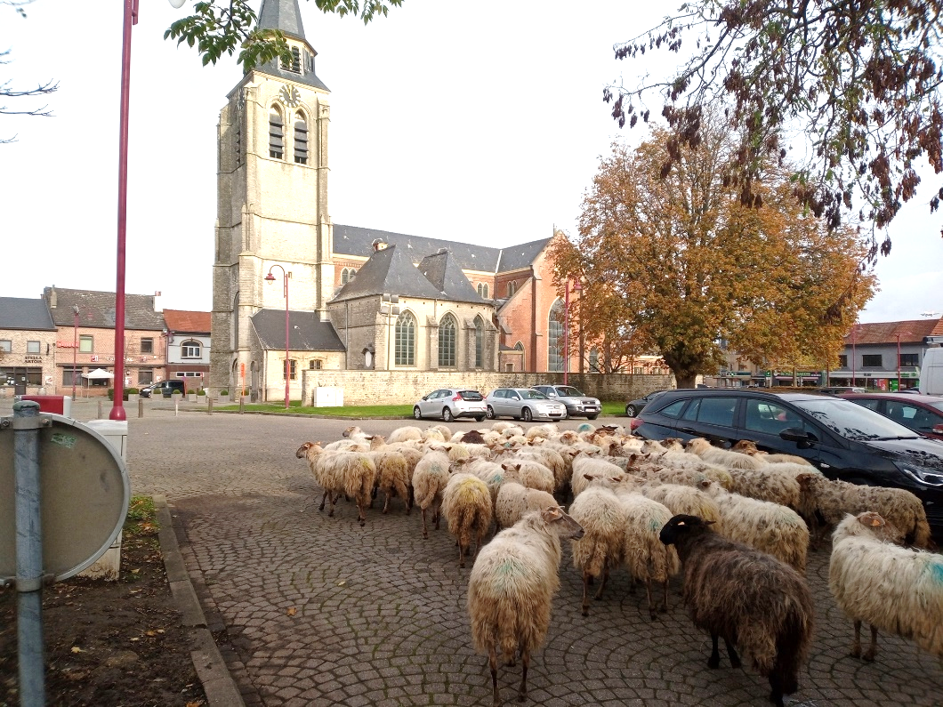
4. Uncertainty about longer term access to land
Farmers need some perspective
“The farmer needs some protection because he invests in his land, but the owner must also have possibilities to put more restrictions on the type of farming”
“I have a 5-year contract. Most farmers who farm in nature reserve, they get a 1 year contract.”
Speckbosch: providing cheap and circular management of green spaces
Some suggestions:
Reserve space for long-term local food production (farmers invest in trees, perennial crops, soil restoration, local community,…)
Define clear conditions towards the farmers (e.g. no external feed for animals)
Find the right balance between protection of nature and protection of the farmers
Dialogue

Slide 18
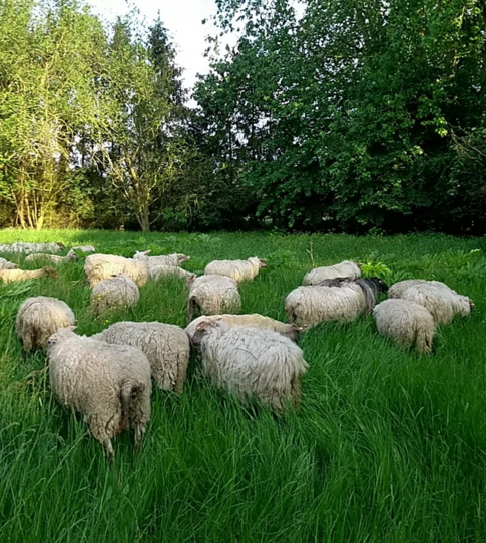
5. Synergies and trade-offs between nature & agriculture
Agriculture supporting nature
“A nice one is a three-horned dung beetle that follows us, so where we have come, you now see it occurring and that is an indicator species.”
Nature supporting agriculture
“We have for example bats, and as we have a problem with a lot of caterpillars that nestle in the tomatoes and grow from the inside out, with the bats the natural system is repaired as the butterflies fly during night and are eaten, so the pest remains under control.“
Nature management limits to agricultural production
“This piece is under botanical management, so I'm not allowed to fertilize. In those fruit trees there is no growth and production, so combination of nature restoration and fruit production is not an option.”
Trees providing shelter for sheep
Sheep improving grassland quality
Some suggestions:
Legislation with room for experimentation
Adjust farming to ecological conditions
Branding
Dialogue

Slide 19
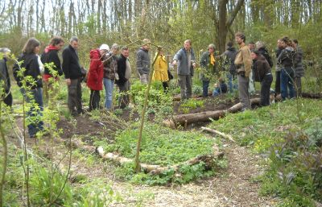
6. Lifelong learning and experimenting
Learning cost
“My business has never really been profitable because I've always experimented a lot, and that costs money to try all kinds of things.”
Knowledge exchange between farmers and conservationists
“Interns on nature management and conservation help us on the integration of nature in our farm.”
Some suggestions
Provide support for transition
Experimental farms
Learning networks
Working together

Slide 20
Final conclusions
Agro-ecological farmers are very committed towards nature and society
Important partners for public authorities
Key is to adapt agriculture to local natural conditions and social needs, which is a permanent learning process
Examples: crops suited to wet conditions, old varieties providing more resilience and more flavour, foodforest as a buffer between built and natural area
Five advices for supporting agro-ecological farming in protected areas
Garantee long term access to land for agro-ecological farming
Be clear about the conditions (and solve uncertainties)
Provide public money for pubic goods
Facilitate dialogue between all local stakeholders
Monitor contribution of agro-ecological farming to ecological, social and economic policy objectives

Slide 21
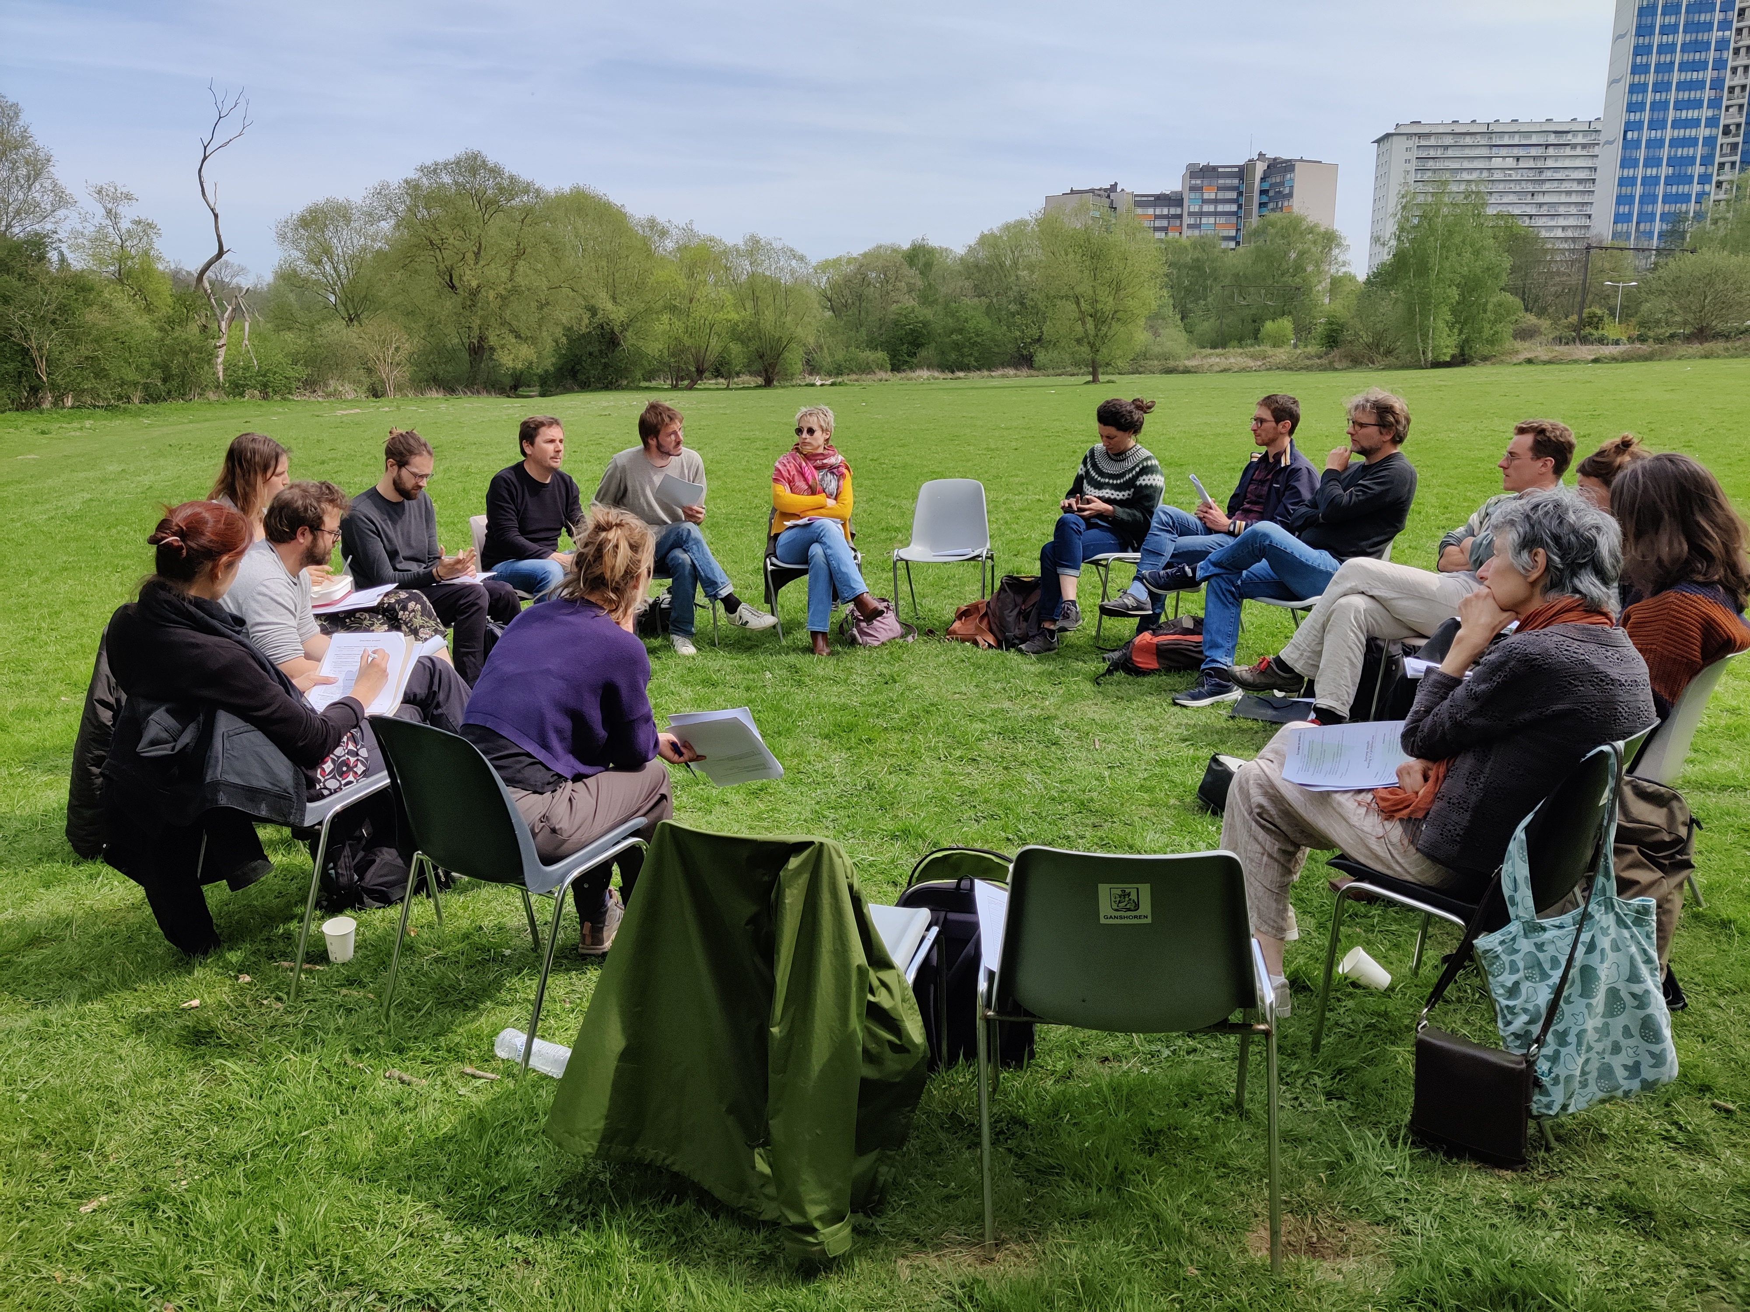

THANK YOU FOR YOUR ATTENTION!

