Slide 1
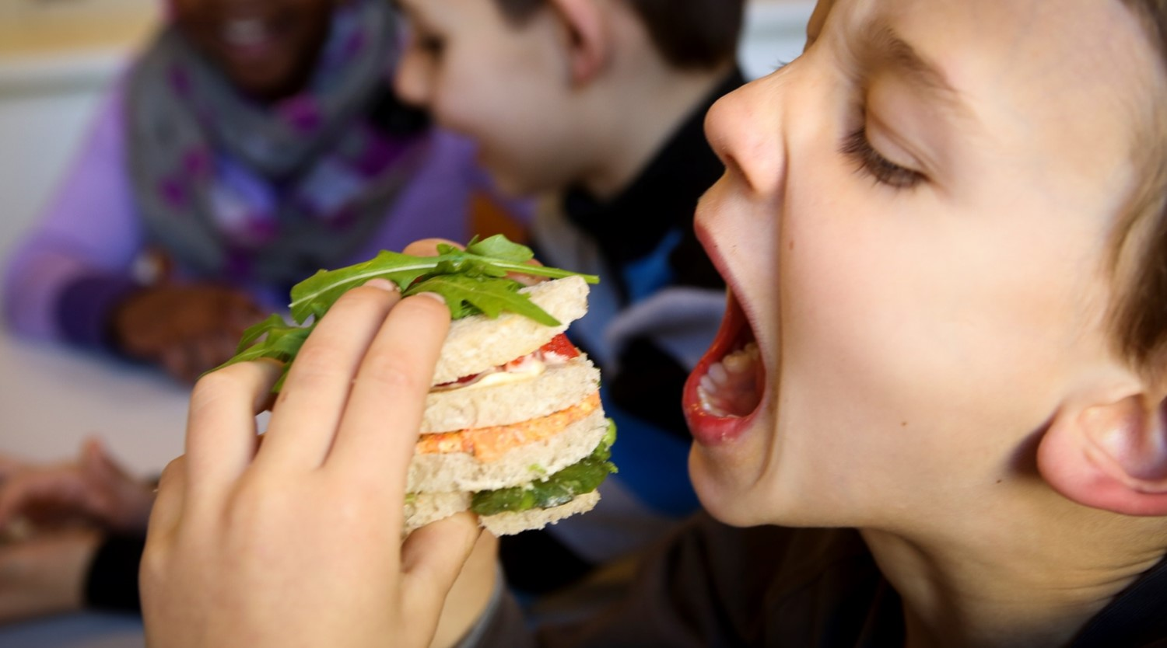
Sustainable criteria in food tenders
City of Ghent, June 2022
Transformative changes for biodiversity and health
Tamara Bruning
Head of Services
Daisy Schellinck senior procurement officer
Sarah Bruinaars
Dietician/projectofficer

Slide 2


Mission
Ghent is a proud city where people like to live, work and enjoy themselves.
A city that breathes and gives breathing space. Everyone is equally different and equally Genthian.
Children can grow and prosper here and people get the chance to develop their talents.
In Ghent we are entrepreneurs and experimenters. With a focus on the world. We create the city together. And make the transition for the next generations to an even better Ghent.

Slide 3
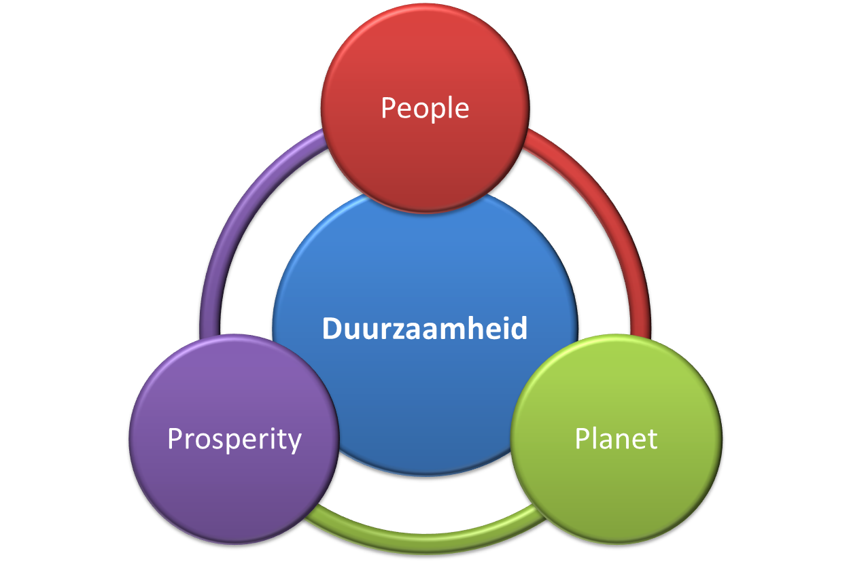

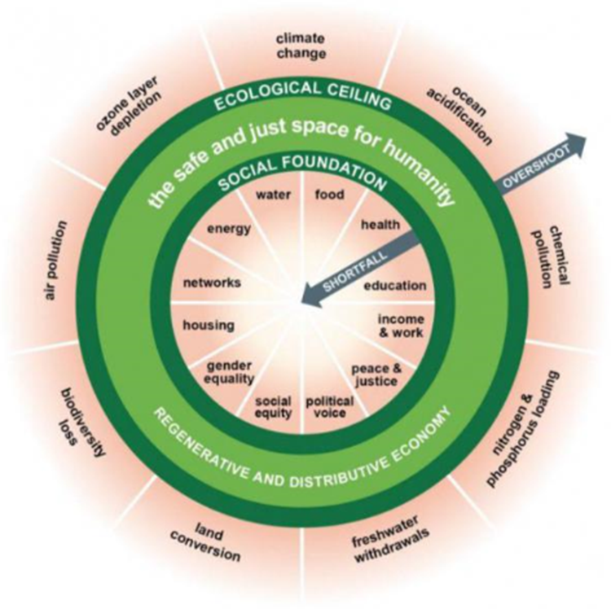
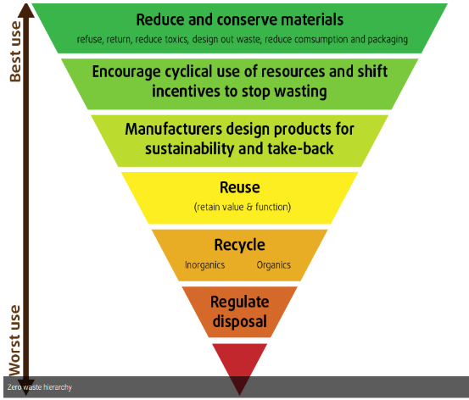
Sustainability

Slide 4
Circular
Production
Waste
management
Distribution
Consumption
Notes:
We try to think more circular. We use 4 pillars to focus on. It is a new (old) way of thinking. We notice a lot of ideas, but upscaling is a challenge and a lot is very experimental.
-Production: how, where, under what circumstances, tracebility, how far up the foodchain you go to identify and regulate
-Distribution: foodmiles, sort transport, impact
-consumption: how sustainable is our diet, impact
-Waste management: how much waste during production, distribution and consumption, cause and actions to take

Slide 5
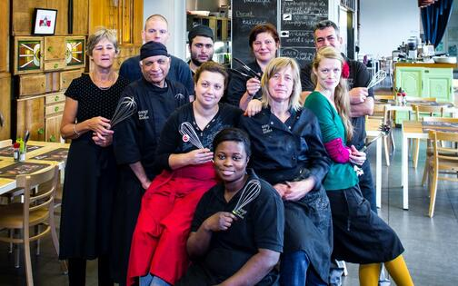
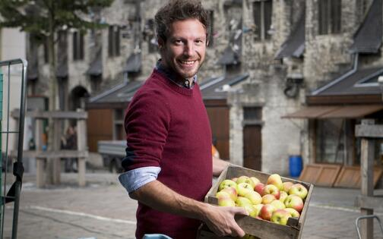
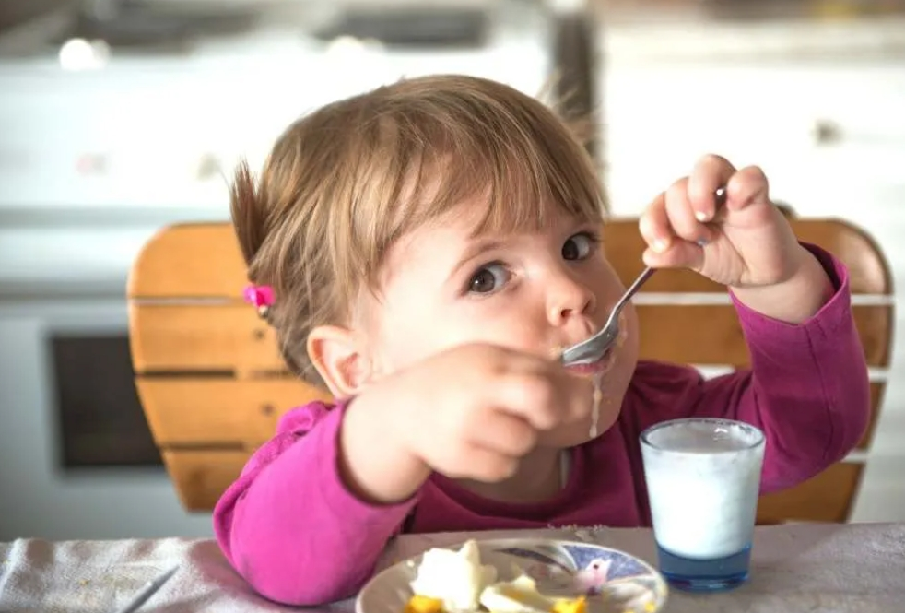
Food strategy
A short and sustainable supply chain
Nothing goes to waste
(avoid & deal with food surplus)
-
Everyone eats sustainable (healthy diet & social cohesion)
-
Notes:
Short and sustainable food chain
The local producer sells his products as directly as possible to the customer. This gives the consumer more feeling for where their food comes from. Farmers, residents and users participate in sustainable urban agriculture.
Everyone eats sustainably
Food is a powerful theme to bring people together around. Initiatives around food can provide better social cohesion and employment. We also focus on access to sustainable, healthy food for all and more sustainable eating behaviour (local, seasonal, organic, vegetarian or fair trade).
Nothing goes to waste
One third of our produced food today still ends up on the rubbish heap, such as the less beautiful vegetables. By looking for a market for surplus food and giving inhabitants tips for conscious purchasing, optimum food storage and processing, Ghent wants to reduce the amount of food waste. When food does become waste, it can still be put to clever use. This can be done by making compost from VGF waste or by having food waste collected separately for processing.

Slide 6

1.Minimizing the environmental impact throughout the
entire lifecycle with a focus on:
a. Rational use of energy and independence from non-renewable resources.
b. Minimizing the impact on local air quality through efficient and environmentally friendly transportation and logistics.
c. Waste prevention.
2.Encouraging sustainable employment of
disadvantaged groups with a focus on:
a. Increasing the opportunities on the labour market for jobseekers from disadvantaged groups -. with specific attention for youth unemployment.
b. Strengthening the sustainable growth of the social economy sector.
3.Encouraging sustainable innovations.
4.Fostering local economic growth with special attention
for start-ups and innovative companies.
5.Integrating and assuring international labor standards
and consistently incorporating principles of fair trade
throughout the supply chain.
6.Encouraging sustainable entrepreneurship amongst
suppliers.
7.Increasing the maturity of the procurement function
and striving towards excellence in procurement.
Procurement
strategy

Slide 7
Main principles
Agro ecology (Organic,…)
Fairly traded
Supply chain
Seasonal
Plantbased
Animal welfare
Foodsurplus/waste
Sustainable fish
Notes:
Translation of the strategy to useable main principles.
Maturity of the market and client + budget determines the choices that can be made

Slide 8
Multi-stakeholders
Environment:
Strategy & info
Health: guidelines
North-South:
Fairly traded
Facility : infrastr, procurement, people
Governance/ political support
Legal support
Procurement & Logistics
procurement: development + granting + follow up
Client
demand for food/drink/catering
Universities, colleges, research
FL GOV
+ cities
NGO’s
Bioforum/EVA/VELT/ICLEI…
Foodsafety regulator
City owned organisations
Suppliers
EU
Citizens
Children
…

Slide 9
Procurement in scope
Sustainable school catering
Sustainable sandwich/cold lunch/cold buffet
Fruit & vegetables
Dairy & eggs
Restaurant specialties
Coffee machines, tea & water dispensers
Sustainable fish
Meat
Wholesalers contract
Breads & pastry
Sustainable fruitjuices & wine
Notes:
Different tenders influence each other. Take the lessons learned from one contract to another. This way evolution is faster.

Slide 10
Sustainable schoolcatering
Social economy
Fairly traded products
Easy handling
Food safety
Traceability
E-numbers
Professional follow up
Thursday veggie day
Flexi meals (50/50)
Sustainable fish ( Prohibited fish: certain tuna, eel, Victoria perch, pangasius, tilapia)
Minimum 20% organic
Seasonal fruit and vegs
Circulationplan/LEZ
Recyclable packaging
Traceability
Decline footprint
Price transparancy
No extra kost
Support organic Supplier/producer
Support fair trade producers/suppliers
Smart menuplanning
Short suply chain

Slide 11
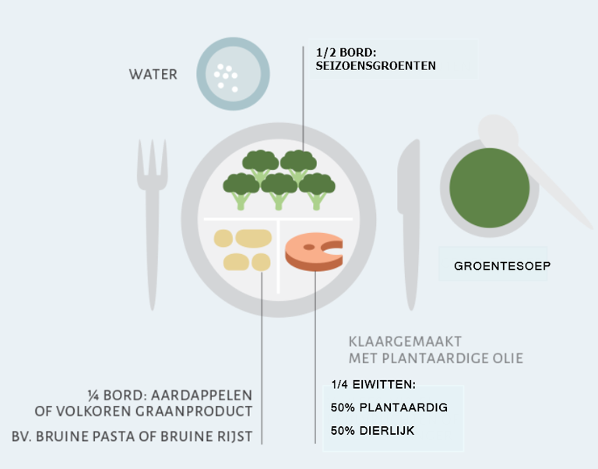
A healthy plate + protein shift
Notes:
Zie info samenstelling maaltijden.

Slide 12



EU and international projects
Commitment to reducing the greenhouse gas (GHG) emissions associated with the food we serve by 25 percent by 2030.
Collaborative Agri-food Chains
A European Project to Support Innovation in Territorial Food Systems
Shifting school meals and schools into a new paradigm, addressing public health and territorial, social and environmental resilience
Notes:
Nieuw: EU-project: School Food 4 Change: schoolmaaltijden als hefboom om het voedselsysteem te verduurzamen.

Slide 13
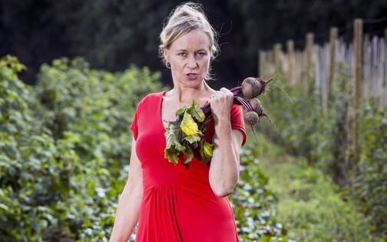
Thank you
Tamara Bruning Daisy Schellinck Sarah Bruinaars
Head of Services Senior procurement officer Dietician/projectofficer
Services@stad.gent aankoop@stad.gent Services@stad.gent

